Slide 1
Cluster meeting: talking about under 3’s
Tuesday 18th March 2025
3pm or 6:15pm
Beverley Jones
(Early Years Consultant)
Alison Rae
(EYFS Adviser)
A copy of the slides can be found at:
Babies and toddlers | Shropshire Learning Gateway

Slide 2

Agenda:
Welcome and introductions
Feedback from previous meeting
- English as an additional
language
- Two-years-olds in pre-schools
3. Using the Early Communication
Screening Tool
4. Signposting, support and training
Q&A’s
Next meetings
What to expect in the EYFS: a parents’ guide

Slide 3

English as an additional language:
“Research tells us that maintaining at least 2 languages is an advantage for later academic achievement. It’s desirable for children who are potentially bilingual and multilingual to be supported in all the languages available to them.
It’s better for young children to communicate with their parents in the dominant home language, especially if parents are not fluent English speakers themselves.”
Help for early years providers : English as an additional language (EAL)

Slide 4
Multicultural development team:
Provide CPD training sessions via Teams.
All sessions cost £25 per delegate.
Course title | 18:00 – 19:30
Embedding cultural diversity | Wednesday 21st May 2025
Identifying and dealing with racists incidents | Tuesday 1st July 2025
Network meeting | 18:00 – 19:00
Supporting refugee families and vulnerable families in the EYFS | Wednesday 7th May 2025
To book places on the above, please contact:
Multicultural.development@telford.gov.uk
Tel: 01952 380828

Slide 5
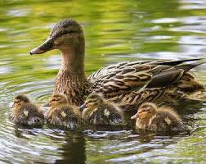
Working with under 3’s:
“[Two-year-olds] think differently, play differently and this is what makes them so special.”
Tassoni, P. Getting it right for two-year-olds (2014)
Proximal attachment shown by 2-year-olds means they need to be physically close to or at least in sight of an adult with whom they have an attachment.
Children who have strong bonds will often seek out physical contact.

Slide 6
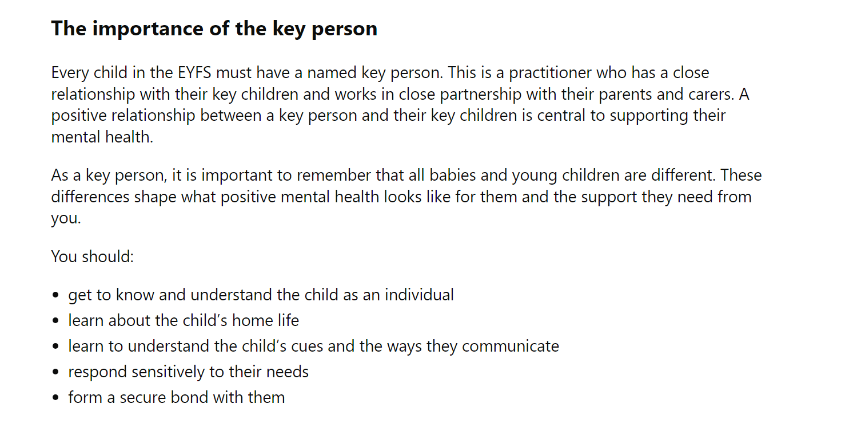
Help for early years providers : Mental health for early years children

Slide 7
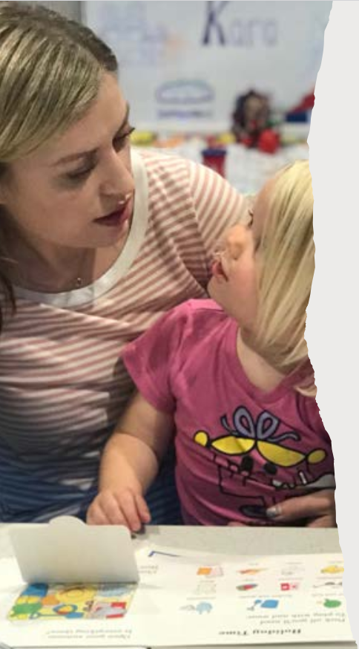
How do you build a trusting relationship with the child and their family?
What to expect in the EYFS: a parents’ guide

Slide 8

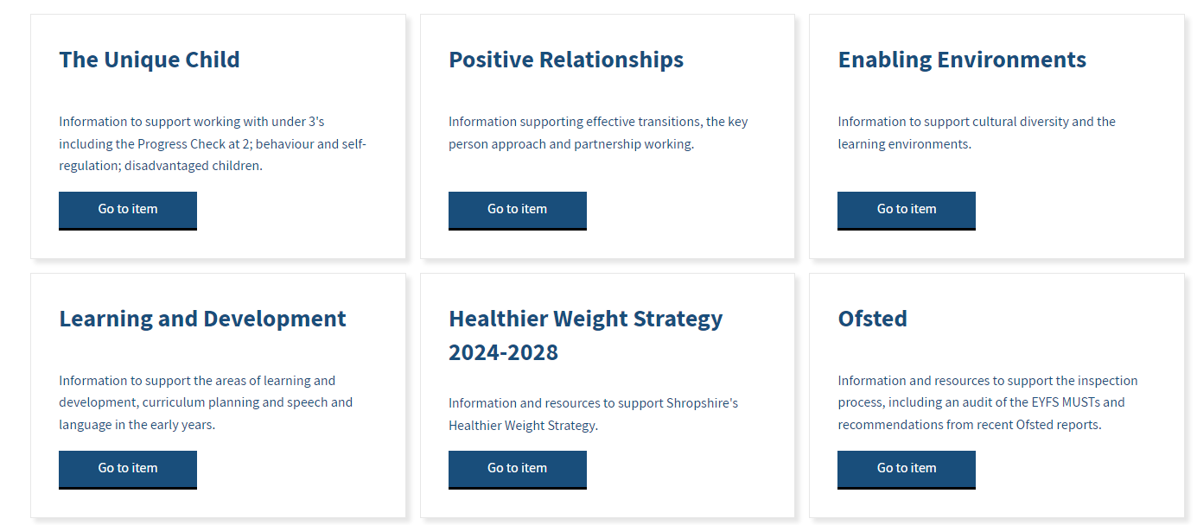
Know How Guides:
working with 2-year-olds
Unique Child
Learning & Development
Effective practice in EYFS | Shropshire Learning Gateway

Slide 9




Early communication screening tool:
Screens children from 24 months identifying delays in understanding and speaking.
Next training session:
4th June 2025
10:00 – 11:30 (Online)
Cost: £40 (PVI)
£80 (Schools)
CPD Schedule and Booking Information 2024 - 2025 | Shropshire Learning Gateway

Slide 10
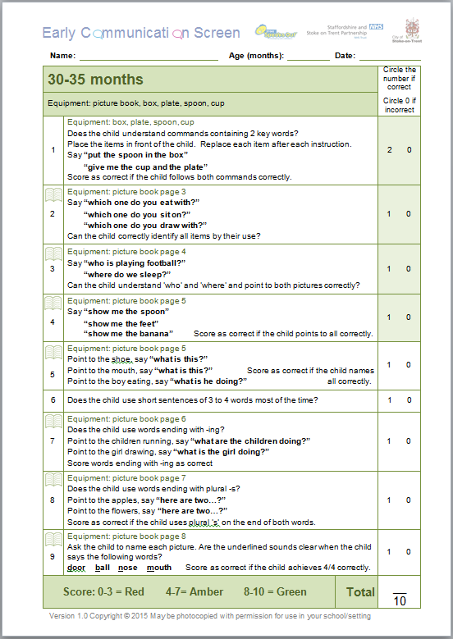
Amelia
32
12/9/15
✓
✓
✗
✓
✗
✗
✗
✗
✗
5

Slide 11
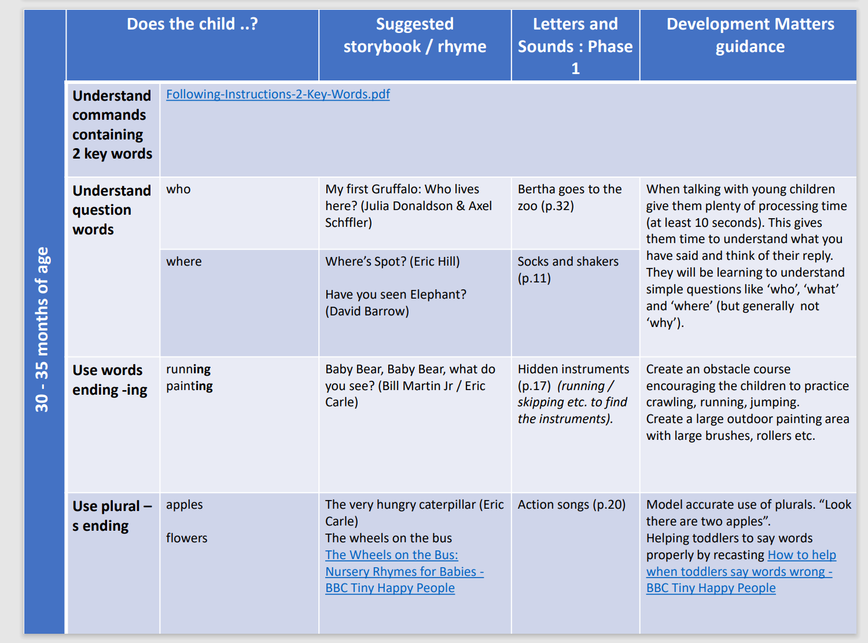

Slide 12
Unique Child
Learning & Development
Early communication
screening tool: What next?
Effective practice in EYFS | Shropshire Learning Gateway

Slide 13

Further reading:
You can download the report for FREE and listen to June and Louise discuss their research on the ‘Talking Early Years’ podcast.

Slide 14
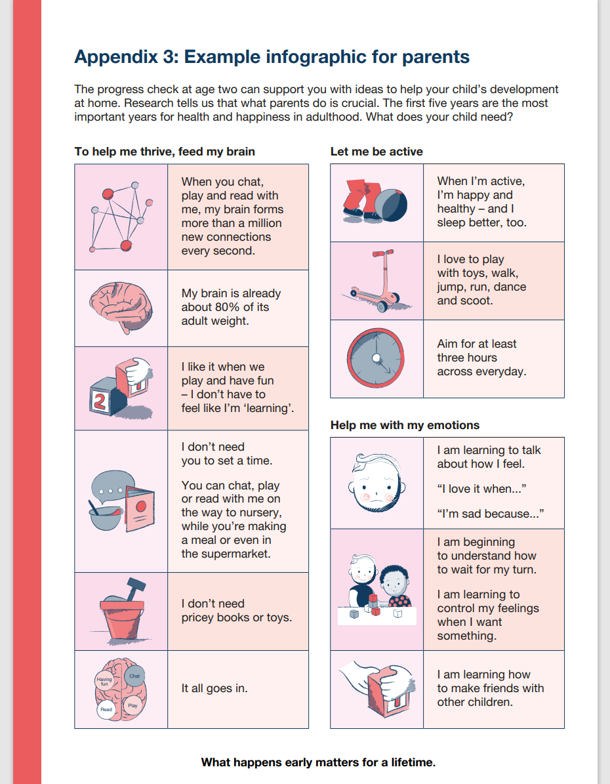
p.40
Progress check at age two – Non-statutory guidance for the early years foundation stage

Slide 15
Future CPD training opportunities:
Food and nutrition for under 4’s (01.04.2025) 13:30 – 15:00
Sharing books together with under 3’s (08.04.2025) 13:30 – 15:30
Early Talk working with under 3’s (12.05.2025 & 19.05.2025)
Early Talk working with parents (16.06.2025) 18:15 – 19:45
Under 3’s outside (09.07.2025) 13:30 – 15:00
Best beginnings: Solihull Approach for under 1’s (15.07.2025) 18:00 – 19:30
CPD Schedule and Booking Information 2024 - 2025 | Shropshire Learning Gateway

Slide 16
Virtual support sessions:
Every Thursday morning 09:30 – 12:00
Beverley Jones
Tel: 01743 254454
Any questions or queries about a child’s learning, development and / or behaviour.
What to expect in the EYFS: a parents’ guide

Slide 17

Q&A’s
Beverley.jones@shropshire.gov.uk

Slide 18
Cluster meeting: talking about 2-year-olds
Tuesday 10th June 2025
15:00 – 16:00 / 18:15 – 19:15
(Online)
Cluster meeting:
talking about babies
Tuesday 3rd June 2025
15:00 – 16:00 / 18:15 – 19:15
(Online)
What to expect in the EYFS: a parents’ guide
CPD Schedule and Booking Information 2024 - 2025 | Shropshire Learning Gateway

