Slide 1
Cluster meeting: talking about two – year-olds Tuesday 10th June 2025 3pm or 6:15pm Beverley Jones (Early Years Consultant)
A copy of the slides can be found at:
Recent slides from CPD training (Learning & Development) |
Shropshire Learning Gateway

Slide 2
Agenda:
Welcome and introductions
2. Updates
3. Reflecting on the Know
How Guide for 2-year-olds
4. Signposting, support and
training
Q&A’s
Date of next meeting
What-to-expect-in-the-EYFS-complete-FINAL-16.09-compressed.pdf
What to expect in the EYFS: a parents’ guide

Slide 3
Changes to the EYFS (September 2025):
Early Years Foundation Stage Safeguarding Reforms (2024) - Foundation Years
Additional information can also be found at:
Help for early years providers : Changes to the EYFS framework
Notes:
This vodcast (12 mins) explores the upcoming Early Years Foundation Stage safeguarding reforms that have been made after the recent consultation on proposals to strengthen safeguarding requirements for Early Years settings. Olivia Mcneill (Senior Policy Advisor – Department for Education) provides further information and explanations behind each of the safeguarding changes.

Slide 4
Early years nutrition guidance:
Guidance from birth
Breastfeeding
Infant formula
Babies aged 6-12 months
- Introducing solid food or
weaning
Guidance for children aged 1-5 years
Early Years Foundation Stage nutrition guidance

Slide 5
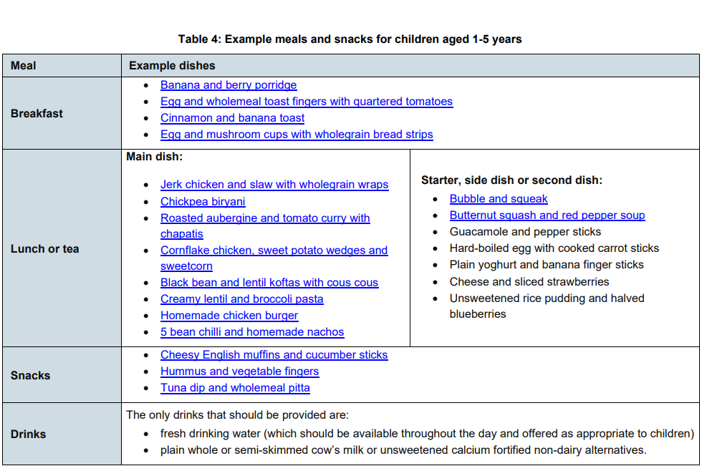
Early Years Foundation Stage nutrition guidance

Slide 6
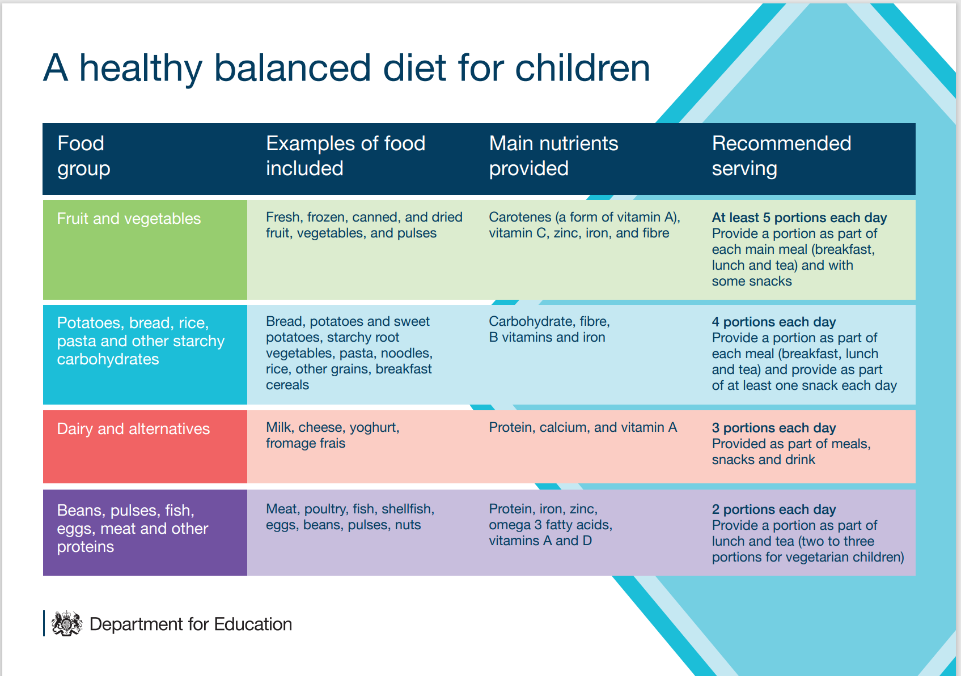
Help for early years providers : Children aged 1 to 5 years guidance
Notes:
What is a healthy balanced diet?
EYFS requirement that states: ‘Where children are provided with meals, snacks and drinks, these must be healthy, balanced and nutritious’.
Good nutrition is important to make sure children:
get the right amount of nutrients they need while they are growing rapidly
don’t consume too much food, which may lead them to become overweight or obese
This is a crucial time to help to reduce health inequalities throughout a child’s life. Some children might not have access to healthy food at home for a number of reasons. You can help influence children’s food choices, which may influence their parent’s choice of food.

Slide 7
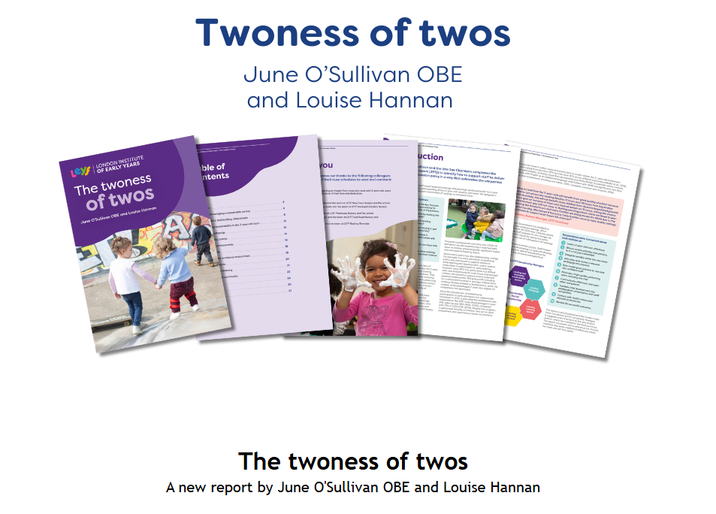
The twoness of twos
Download the latest report:
Twoness of twos
Notes:
Another recently published report …
Building on from the original report in 2012, the most recent report continues to advocate for specific EY training for leading a 2 –year-old room. The Twoness of Twos report reflects research conducted within 23 settings, where leadership was a theme that wove throughout the responses highlighting a shared concern about insufficient training available with a laser focus on two-year-olds.

Slide 8
Key messages: Talking Early Years: Twoness of Twos - LEYF Nurseries
Greater understanding of neuroscience, so apply this to supporting and understanding 2-year-olds:
Creating language rich-environments
Provision with lots of play (planned and unplanned) for their curiosity and sensory learning
Adults emotionally attuned to the rhythm of the 2 – year-olds’ day.
“These days appears to be a focus on the environment looking like a show room, neither pedagogically sound, language-rich or emotionally safe, so it is time to talk more about this.”
Part 3 - Early years curriculum: Making progress through
knowing and remembering more - YouTube
Notes:
In reality, two-year-olds are on a huge development pathway. Their brains are 75% formed and we have to create the right environment to help them continue to grow. Nowadays, we know a lot more about neuroscience, so we need to apply this new knowledge and become sensitively attuned to two-year-olds, helping them think beyond themselves, figure out how to regulate themselves, understand their space and their place in the local community and find their voice. To do this, we need staff with the ability to create language-rich learning environments with lots of play including many planned and unplanned activities that provides for their curiosity, sensory learning while also scaffolding their learning to stretch them but, most importantly, be emotionally attuned to the rhythm of the day. These days appears to be a focus on the environment looking like a show room, neither pedagogically sound, language-rich or emotionally safe, so it is time to talk more about this.
Video clip illustrating importance of a creating a language rich-environment and providing opportunities for two-year olds to show their curiosity and engage in sensory learning.
10.41 – 16.08

Slide 9
Any questions?

Slide 10
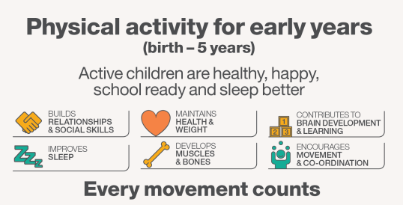
Know how guide working with 2-year-olds:

Slide 11
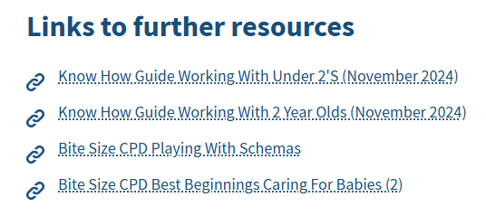
Birth to 3-year-olds | Shropshire Learning Gateway

Slide 12
Know how guide working with 2-year-olds:
Learning & development | Assessment | Safeguarding and welfare requirements
-Building a two-year-old’s brain -The emotional environment -The physical environment -Importance of play -Characteristics of effective learning -The areas of learning and development -The prime areas | -Early speech and language chart -Observational check points -The progress check at 2 To be added: information on the Early Talk 0-5 working with under 3’s toolkit and online training links | These will be updated following the new requirements from 1st September 2025.

Slide 13
Signposting, support and training:
What-to-expect-in-the-EYFS-complete-FINAL-16.09-compressed.pdf

Slide 14
Virtual support sessions:
Every Thursday morning 09:30 – 12:00
Beverley Jones
Tel: 01743 254454
Any questions or queries about a child’s learning, development and / or behaviour.
What to expect in the EYFS: a parents’ guide

Slide 15
CPD opportunities:
Early years – learning & development and safeguarding
Foundation Years https://www.foundationyears.org.uk/
Shropshire Best Start in Life Programme Shropshire Best Start in Life Programme | Shropshire Council
CPD Schedule and Booking Information 2024 - 2025 | Shropshire Learning Gateway

Slide 16
Any questions?
Beverley.jones@shropshire.gov.uk

Slide 17
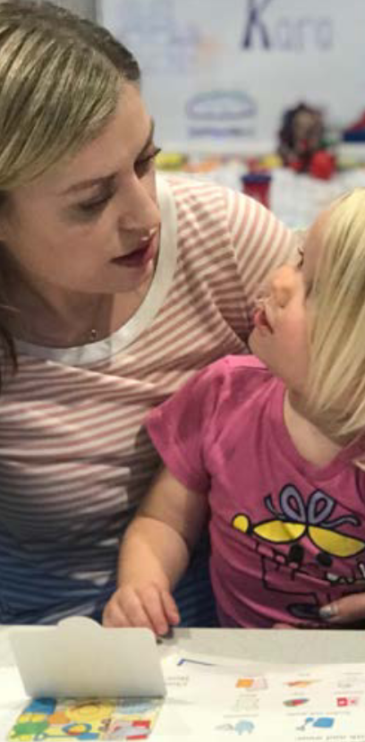
Cluster meeting: talking about 2-year-olds Tuesday 18th November 2025 15:00 – 16:00 / 18:15 – 19:15 (Online)
Cluster meeting:
talking about babies
Wednesday 12th November 2025
15:00 – 16:00 / 18:15 – 19:15 (Online)
What-to-expect-in-the-EYFS-complete-FINAL-16.09-compressed.pdf
CPD Schedule and Booking Information 2024 - 2025 | Shropshire Learning Gateway

