Slide 1
CPD training & resources to support C&L:
3–4-year-olds
Early Talk Boost
Early Talk working with parents
2-3-year-olds
Early Talk working with parents
0-2-year-olds
Early Talk working with parents
Early Talk working with under 3’s
Early Talk working with under 3’s
Letters and Sounds Phase 1
(see bite-size CPD)
Early communication screening tool
Further details can be found at: CPD Early Years and Schools | Shropshire Learning Gateway
January 2025

Slide 2
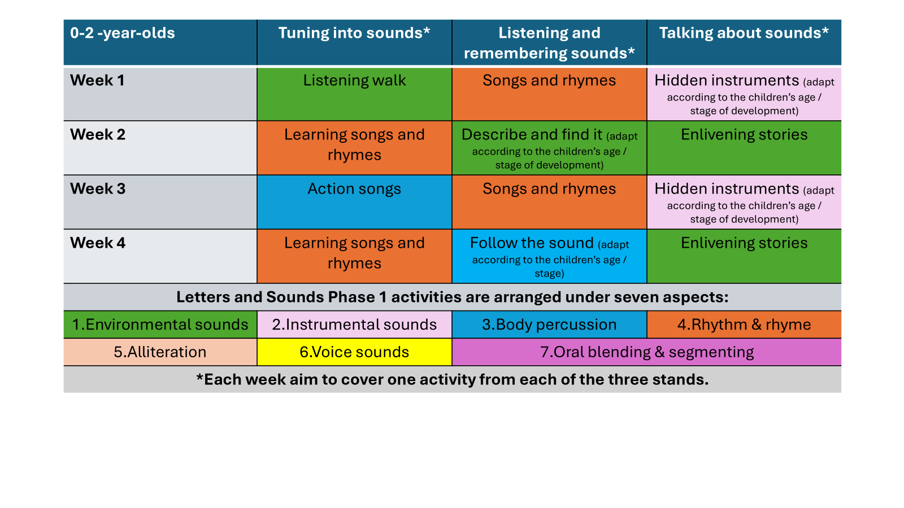
Example of planning for Letters and Sounds Phase 1:
Speech and language | Shropshire Learning Gateway

Slide 3
Example of planning for Letters and Sounds Phase 1:
Speech and language | Shropshire Learning Gateway
2 -3 -year-olds | Tuning into sounds* | Listening and remembering sounds* | Talking about sounds*
Week 1 | Listening walk | Songs and rhymes | Words about sounds
Week 2 | Action songs | Describe and find it | Musical show and tell (adapt according to the children’s age / stage of development)
Week 3 | Drum outdoors (adapt according to the children’s age / stage of development) | Songs and rhymes | Sound story time (adapt according to the children’s age / stage of development)
Week 4 | Rhyming books | Noisy neighbour 1 | Enlivening stories
Week 5 | Grandmother’s footsteps | Songs and rhymes | Watch my sounds (adapt according to the children’s age / stage of development)
Week 6 | Roly poly | Matching sounds (adapt according to the children’s age / stage of development) | Enlivening stories
Letters and Sounds Phase 1 activities are arranged under seven aspects:
1.Environmental sounds | 2.Instrumental sounds | 3.Body percussion | 4.Rhythm & rhyme
5.Alliteration | 6.Voice sounds | 7.Oral blending & segmenting
*Each week aim to cover one activity from each of the three stands.

Slide 4
Example of planning for Letters and Sounds Phase 1:
Speech and language | Shropshire Learning Gateway
3 - 4 -year-olds | Tuning into sounds* | Listening and remembering sounds* | Talking about sounds*
Week 1 | A listening moment | Chain games | Silly soup
Week 2 | New words to old songs | Mrs Browning has a box | Give me a sound
Week 3 | Listen to the music | Matching sounds | Socks and shakers
Week 4 | Our favourite rhymes | Follow the sound | Story sounds
Week 5 | Sounds around (incl. tongue twisters) | Finish the rhyme | Noisy neighbour 2
Week 6 | Mouth movements | Musical corners | Odd one out
Letters and Sounds Phase 1 activities are arranged under seven aspects:
1.Environmental sounds | 2.Instrumental sounds | 3.Body percussion | 4.Rhythm & rhyme
5.Alliteration | 6.Voice sounds | 7.Oral blending & segmenting
*Each week aim to cover one activity from each of the three stands.

Slide 5
Example of planning for Letters and Sounds Phase 1:
Speech and language | Shropshire Learning Gateway
3 - 4 -year-olds (cont.) | Tuning into sounds* | Listening and remembering sounds* | Talking about sounds*
Week 7 | Teddy is lost in the jungle | Target sounds | Mirror play
Week 8 | Adjust the volume | Describe and find it | Singing songs
Week 9 | Action songs | Matching sound makers | Enlivening stories
Week 10 | Rhyming soup | Noisy neighbour 1 | Animal sounds
Week 11 | Digging for treasure | Rhyming pairs | Words about sounds
Week 12 | Voice sounds | Our sound box / bag | I know a word
Include these activities the term before moving into Reception: | Toy talk / cross the river | Segmenting / say the words | Talk about different phonemes (sounds)
Letters and Sounds Phase 1 activities are arranged under seven aspects:
1.Environmental sounds | 2.Instrumental sounds | 3.Body percussion | 4.Rhythm & rhyme
5.Alliteration | 6.Voice sounds | 7.Oral blending & segmenting
*Each week aim to cover one activity from each of the three stands.
Notes:
There are planning sheets for ages under 2’s, 2–3-year-olds and 3–4-year-olds.

