Slide 1
Early Years Network Meeting
Tuesday 18th March 2026
19:00 - 20:30

Slide 2
Agenda:
Welcome with Alison Rae & Introduction for Sarah Kynaston
Early Help 0-5 Team – An Introduction with Alex Morris Perkins
Early Years Apprenticeships with Shrewsbury College – Jules Rhodes
Early Years Provider Agreement and Hourly Rates with Dan Steele
Early Talk Boost Tracker - Laura Taylor and Rachel White
Early Years Safeguarding update with Charlotte Percival

Slide 3





Early Help
0-5 Team
An Introduction
Alex Morris-Perkins

Slide 4



Early Help 0-5 Team
What is our aim?
To reach children aged 0-5 years with vulnerabilities early.
To improve outcomes for children aged 0-5 years and prevent their needs from escalating.
Who are we?
A team of 5 Early Help Family Support Workers covering Shropshire, and a Locality Lead, based in the Early Help Family Hubs.

Slide 5
What do we do?
The 0-5 Team provides focused support to those families needing specific help. This would include a family’s Early Help Assessment and Plan. These tools will help us provide the right support to meet the needs of the family, and will include working with others.
The Early Help 0-5 Team works closely with other professional teams to support our youngest children aged 5 years and under, and families expecting a baby.
The support includes face to face contact with families in their homes, and multi-agency Team Around the Family meetings.
NB: Where there are older siblings in a family, the focus of support needs to be for the under fives and their parents, with older siblings having low level needs that can be met by other services. If there are older siblings with higher needs, families can be supported by the Early Help North, Central and South Hubs, or EHAST.

Slide 6

What can we help families with?
We support families across a range of needs which affect children as you can see in the 'Circle of Support'.

Slide 7
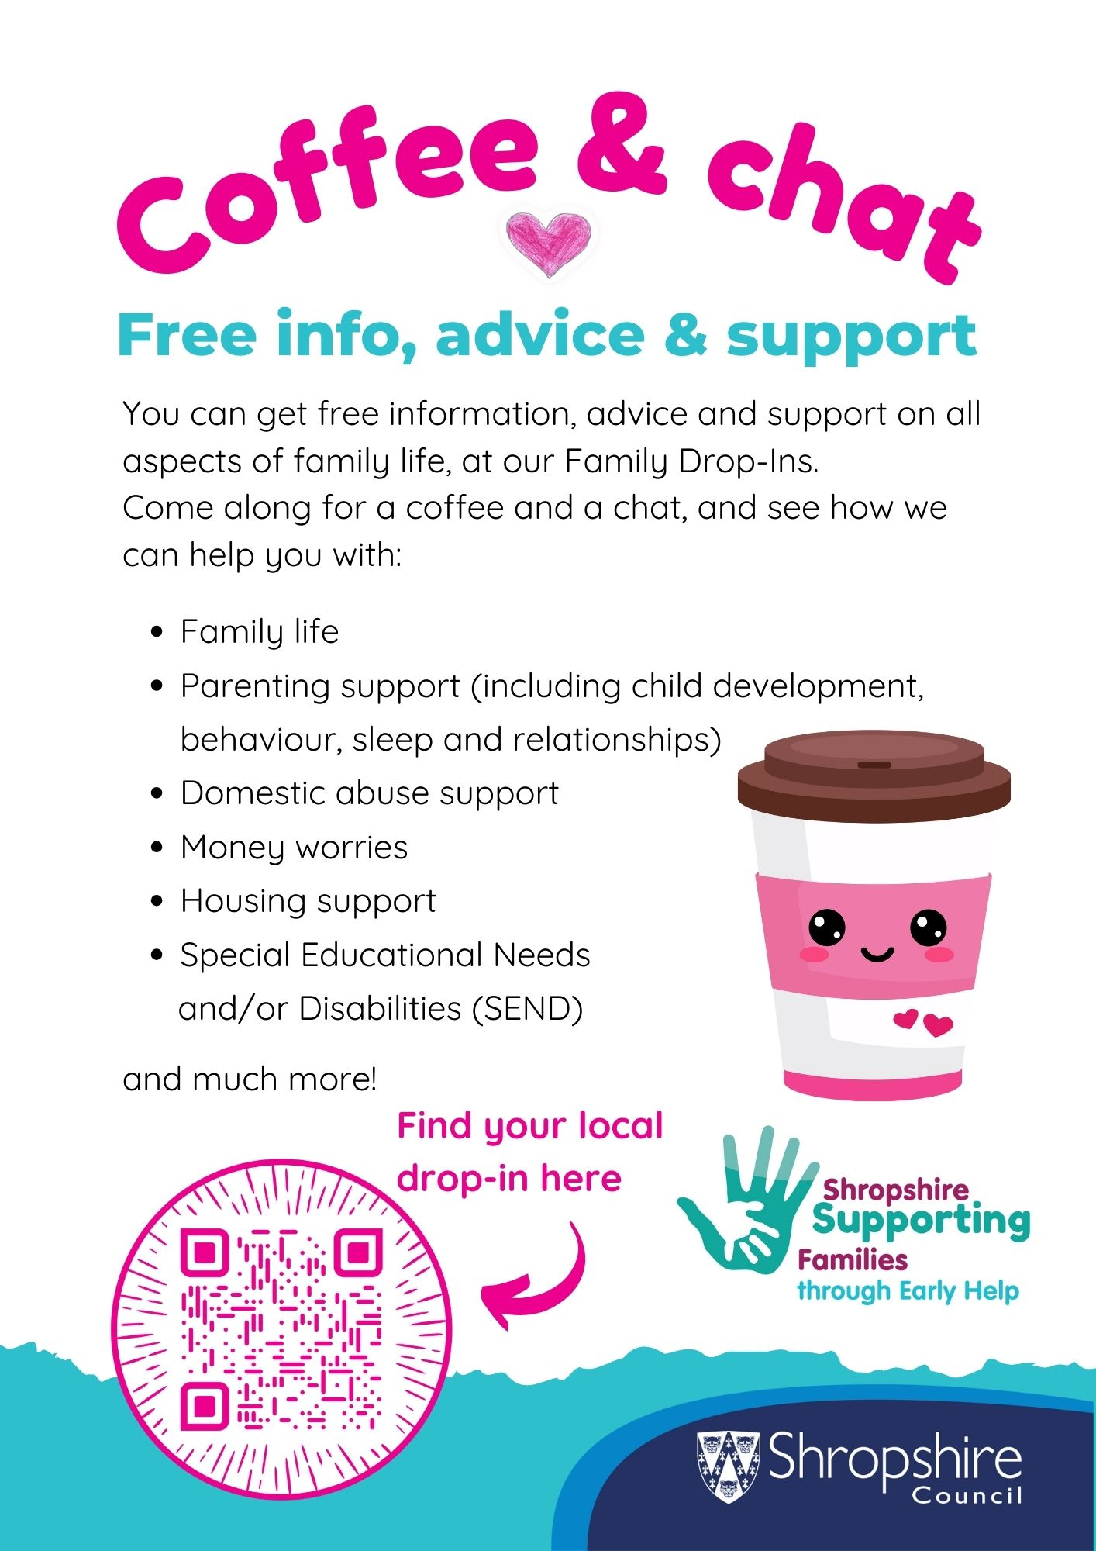
Family Hub Drop-ins
The Early Help offer also includes opportunities to drop-in to talk to a dedicated team member about anything they may be struggling with. Families can drop into their nearest family hub, contact Shropshire's First Point of Contact (FPOC) or explore the Early Help website for hands-on digital information.
The poster here has a QR code which will take you to the Family Information Service web pages which has the dates/times of the drop-ins in each area.

Slide 8

Open Access Health Visitor Clinics
Each hub also has Open Access Health Visitor Clinics which is also attended by Early Help Family Support Worker. Follow this link:
Welcome to the Shropshire Together Community and Family Directory - Shropshire Together Community Directory
Families can see a Health Visitor to talk about their child's health and development without the need for an appointment.

Slide 9

Parenting Support
Shropshire Council Parenting Team: Offer courses, both virtual and face to face. For more information please call 01743 250950 or visit The Parenting Team | Shropshire Council
Togetherness ‘Solihull Approach’ website'Understanding your child' courses – for Shropshire residents – please use code ‘DARWIN18’, and lots resources/tips on the website too – more information here Home - Togetherness

Slide 10
How do professionals refer into the 0-5 Team?
For consultation and guidance if professionals are worried about a child, please contact Shropshire Council’s First Point of Contact on 0345 6789021, who will gather and forward information to the 0-5 Team should this be the appropriate team via EHAST. Other support services will be recommended if these are more suitable depending on the family’s needs.
For general information about the 0-5 Team and to discuss developing links please contact:
Alex Morris-Perkins
Early Help 0-5 Team Locality Lead
Alex.morris-perkins@shropshire.gov.uk
For further information, please visit the Early Help Website:
https://next.shropshire.gov.uk/early-help/

Slide 11
Early Years Apprenticeships with Shrewsbury College
Jules Rhodes

Slide 12
Apprenticeships & T Levels

Slide 13
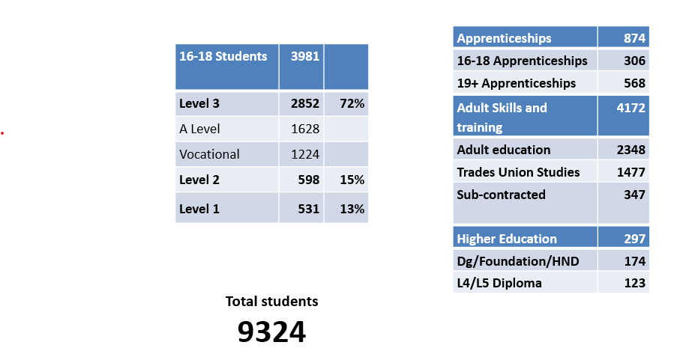
Shrewsbury Colleges Group Context
July 2024: Students and curriculum

Slide 14
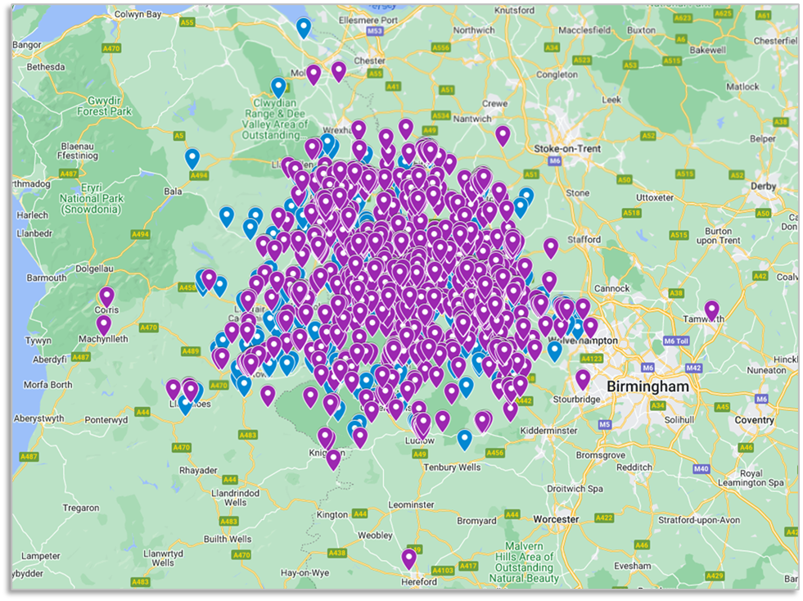
Where do our students come from?

Slide 15
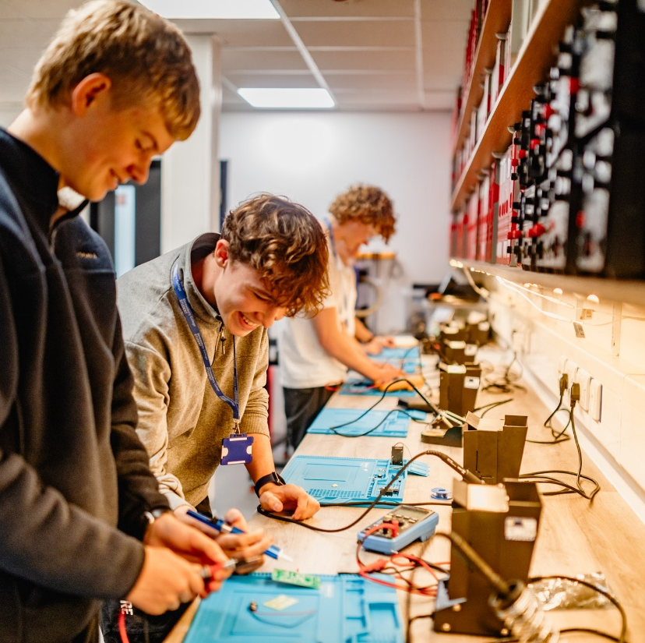

Apprenticeships

Slide 16

What is an Apprenticeship?
A paid job that combines hands-on work experience with off-the-job training.
Apprentices spend at least 20% of their working hours in learning.
Leads to a nationally recognised qualification.
£8 per hour with a maximum contract of 40 hours per week (from April 1st)
Suitable for anyone aged 16+, not in full-time education.
Fully or mostly funded training costs for those 16 – 24 years, 5% there after (worst case)
Age incentive and grants can be available to employers (new incentives in place from August 26).
Assessed against knowledge, skills and behaviours (normally at the end, via End Point Assessment / EPA).

Slide 17
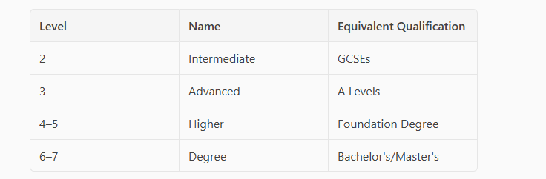
Benefit of becoming an Apprentice
Earn while you learn.
No tuition fees.
Gain industry experience.
Build professional networks.
Pathway to further education or employment.
Levels Available

Slide 18
Duration of an Apprenticeship?
Apprenticeships typically last 8 months to 5 years, depending on the level and subject.
They are available to start at all points of the year from various employers, but mainly September and January.
Minimum duration: 8 months (new foundation level)
Training includes:
80% on-the-job
20% off-the-job learning (e.g. college day release, online, mentoring)

Slide 19
Eligibility Criteria and Onboarding
Basic Eligibility Requirements
Applicants must be at least 16 years old, not in full-time education, and legally allowed to work in the UK.
Programme Specific Criteria
Additional requirements such as prior qualifications or experience may apply depending on the apprenticeship programme. Typically, this is GCSE 4/C or above in math and English for a Level 3 standard.
Assessment Support and Onboarding
Initial assessments, interviews, and guidance help determine applicant suitability and prepare them for apprenticeship success.

Slide 20
Referral Process
Multiple Referral Pathways​
Candidates can be referred via job centres, schools, or apply directly through the college admissions portal.​
Initial Consultation​
The college assesses candidates' interests, qualifications, and career goals during the consultation.​
Vacancies can be found on the National Apprenticeship Service website:
Find an apprenticeship - GOV.UK
Matching and Interviews​
Candidates are matched with apprenticeship opportunities and interviews are arranged with employers.​
Ongoing Support​
Support includes CV writing, interview preparation, and understanding contracts throughout onboarding.​

Slide 21

Apprenticeships at Shrewsbury College
Accounting (Level 2 – 4)
Building & Construction (Level 2 – 4)
Business (Level 2-3)
Childcare & Education (Level 2 – 3)
Electrical Installation (Level 3)
Engineering (Level 2 – 4)
Fabrication and Welding (Level 2 – 3)
Outdoor Activity Instructor (Level 3)
​
Hairdressing (Level 2)
Motor Vehicle (Level 2 – 3)
Land Engineering (Level 2-3)
Management (Level 3 – 4)
Plumbing & Gas (Level 3)
Property Maintenance (Level 2)
IT and Digital (Level 3)
Contact the apprenticeship team – employer@shrewsbury.ac.uk - 01743 653444

Slide 22

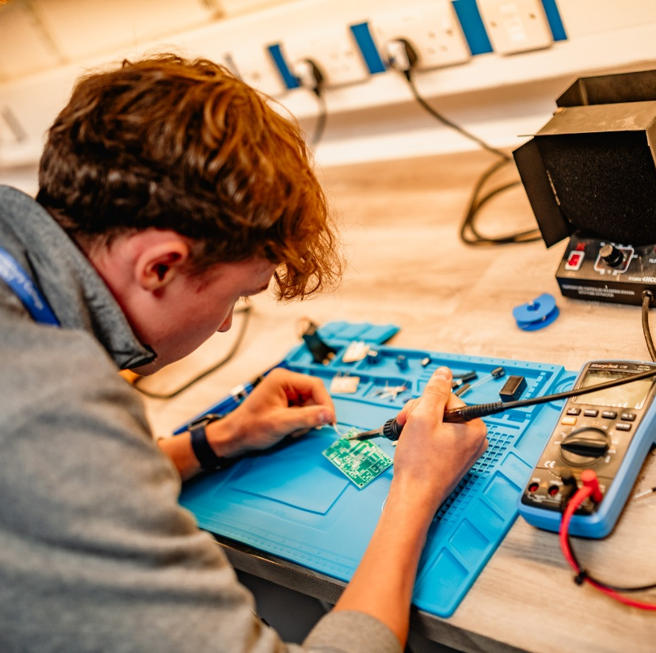
T Levels

Slide 23

What are T Levels?
T Levels were introduced in ‘wave 1’ in September 2020.
They are a vocational qualifications equivalent to three A Levels.​
They have been designed in partnership with employers.
There are currently 21 T Levels available, which are then split into further ‘specialisms’.
They were planned to replace some Level 3 qualifications, such as BTEC Extended Diplomas as part of the Level 3 reform, which is now at a ‘pause and review stage’.
2-year courses attending college between 15 and 22 hours per week.
They are only available to 16–19 year-olds.

Slide 24
They are assessed via Core exams, Employer Set Projects and Occupational Specialisms.
Students are required to undertake at least 315 hours of Industry Placement as part of the qualification – this is 750 hours for health and education (including childcare). This can be undertaken at any point over the 2 years, but must be ‘vocationally relevant’ to their T Level. SEND Students: Up to ⅓ of hours can be in on-site college facilities before entering the workplace.
The ‘Employer Support Fund (ESF)’ is available to reduce financial impact to employers for placements – such as PPE. Access is specifically for SMEs providing placements for T Levels other than Construction and Health, and for all-sized employers offering placements for the Construction or Health T Level routes.
Graded by Distinction*, Distinction, Merit, Pass, Fail and can be a ‘license to practice’ qualification, in areas such as in health.
They allow for several progression routes – university/higher education (carry UCAS points), apprenticeships and employment.

Slide 25
T Levels on offer at Shrewsbury College
Education and Childcare
Health
Digital Production, Design and Development
Design, Surveying and Planning for Construction
Engineering, Manufacturing, Processing and Control
Management and Administration
94 Shrewsbury College students completed last year
97% pass rate compared with 89% nationally
29% Distinction* and Distinctions compared 16% nationally
82% Distinction*, Distinctions and Merits compared with 62% nationally

Slide 26
Early Years Provider Agreement
Launching April 2026
Updated statutory guidance published Monday 2nd February
Provider Agreement updated to reflect these changes
New Launch date TBC: April 2026
Key changes to: Ofsted, transparency, flexibility and charging
Addition of FIS Termly Audits (Information gathering exercise)

Slide 27
Hourly Rates 26/27
Early Years funding block allocation each year
Each LA granted different levels of finance, based on census data
97% pass through rate, 3% is retained for centralised costs
Why? SEND Officers, Funding & Systems team, L&D, CPD.

Slide 28
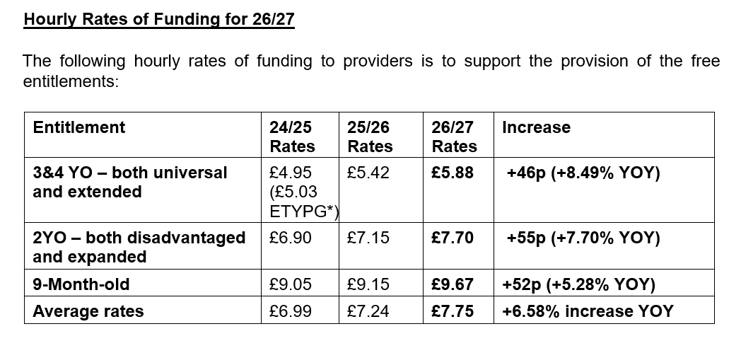
Hourly Rates 26/27

Slide 29
General reminders
Termly EY Census Collection
Now that that the EY census data is being captured via the Portal each term, you will be required to complete your census before it will allow you to submit your Actual headcount.
Please note that this does not include school-based settings who will continue to submit their census data in the usual way.

Slide 30
General reminders
Which providers and children are in the scope for the early years census?
All English early years providers who are offering the funded entitlements in private, voluntary and independent sectors are within the scope of the early years census.
Providers must provide the data for the early years census at individual child level for children taking up a funded place at your setting.
Only data for funded children at your setting should be provided.

Slide 31
Early Years Talkboost Online Tracker
Notes:
Introduce ourselves
Background around ELSEC
Further training for early talkboost will shortly be available on Shropshire learning gateway this will be 28th of April 9-12 and 6th of May 9-12

Slide 32
Why use the tracker?
The tracker helps to create graphs to understand the development areas for the child and can be shared with professionals such as speech and language therapists.
It can help with looking at trends and seeing if there are common areas of development.
It can visualise the journey a child has taken through the talkboost programme from before and after the intervention
Early Talk Boost Tracker Log in
Notes:
This can support conversations with parents as it is visual.
Helps you think about your provision within nursery.
Helps support a S&L therapist if an assesement is needed and having the evidence supports you cycle of assessment for that child.

Slide 33
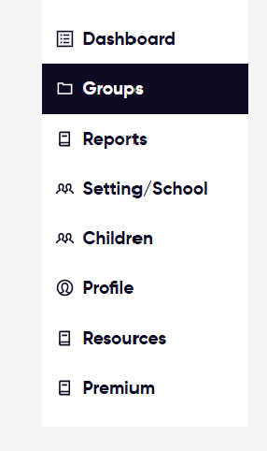

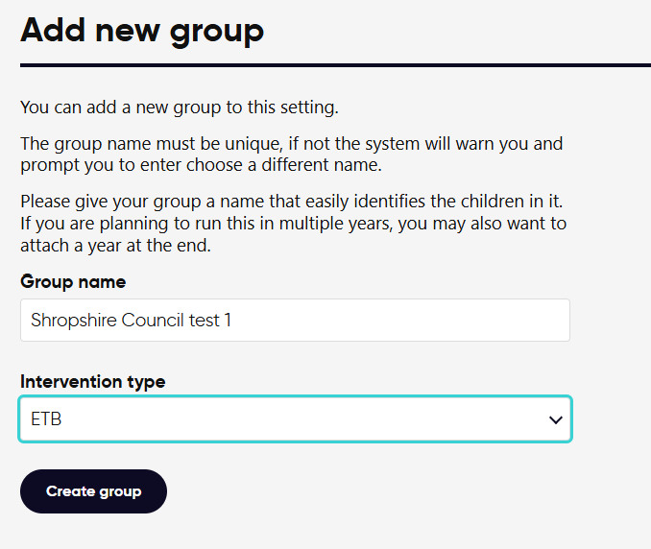
Adding a child to the tracker
Notes:
First go to the group tab on the side
then add new group
Create a name for this group it should include the year you are doing this
The intervention type has to be ETB

Slide 34
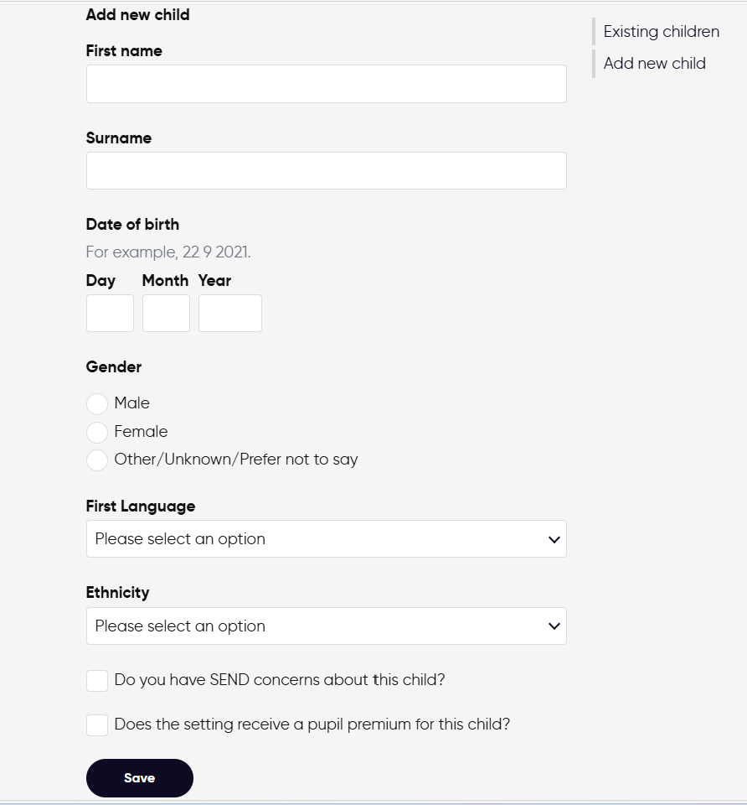
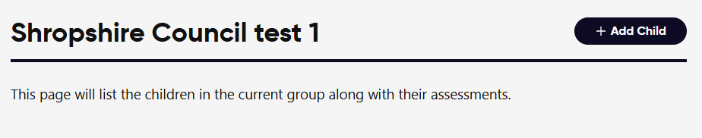
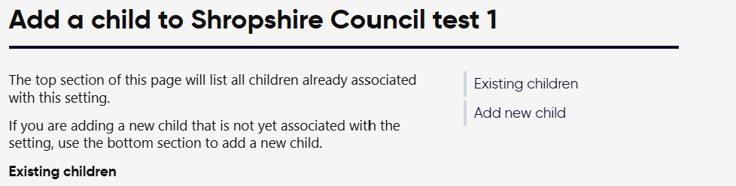
Adding a child to the tracker
Notes:
Then click the button to add child
Add new child on the next page
Add the details ensuring you check the date of birth as you add it
With the two statements at the bottom only tick if appropriate

Slide 35
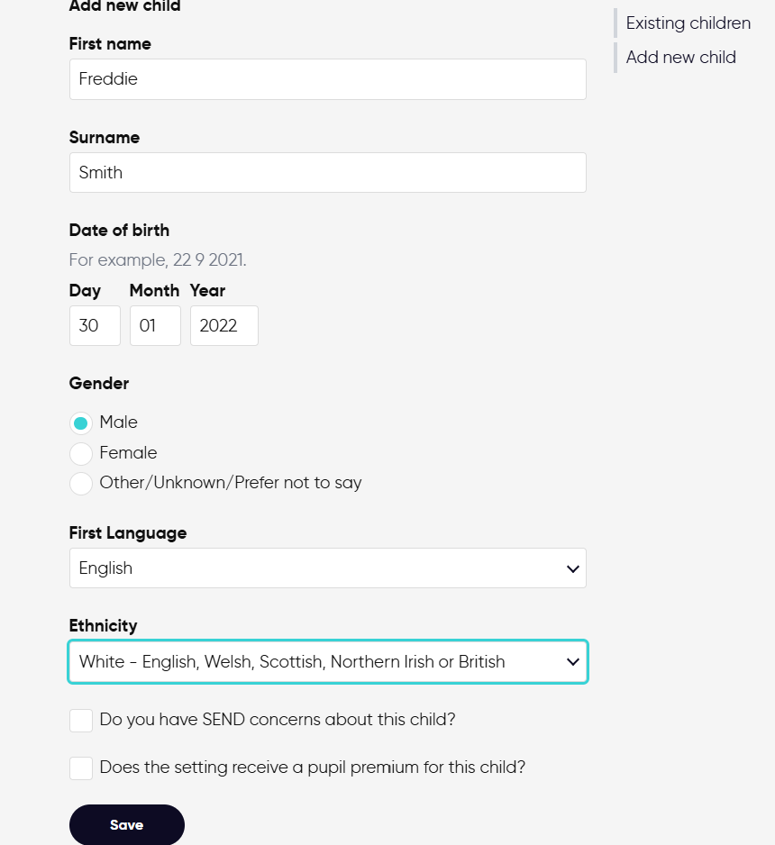
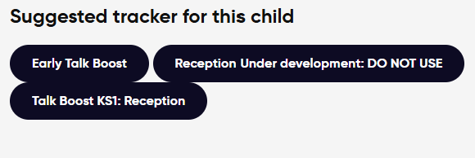
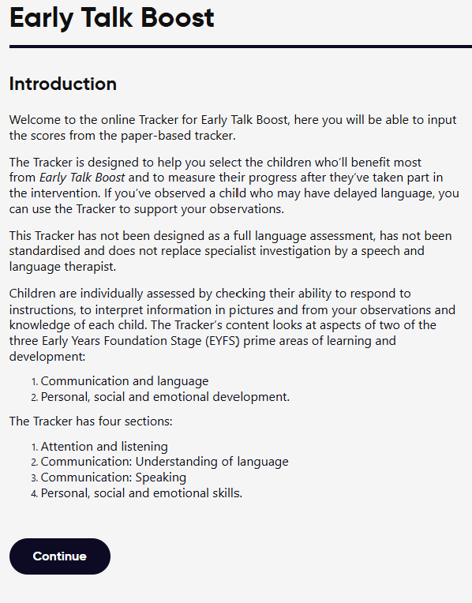
Adding a child to the tracker
Notes:
Now press save with all of the details inputted
Then select the tracker early talk boost
Then press continue

Slide 36
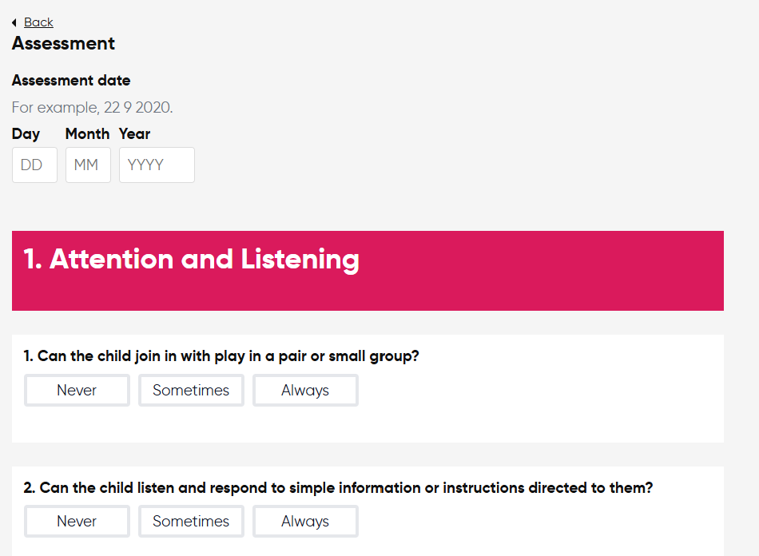
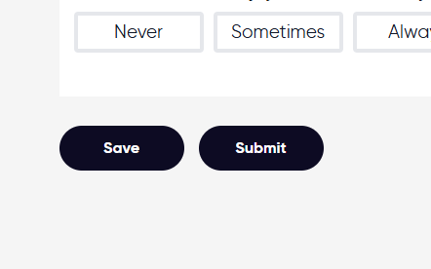
Adding an assessment
Notes:
Enter the assessment date (make sure this is the assessment date and not date of birth)
Go down through and score as scored on the tracker you have completed
Then submit (save if returning to at a later date)

Slide 37
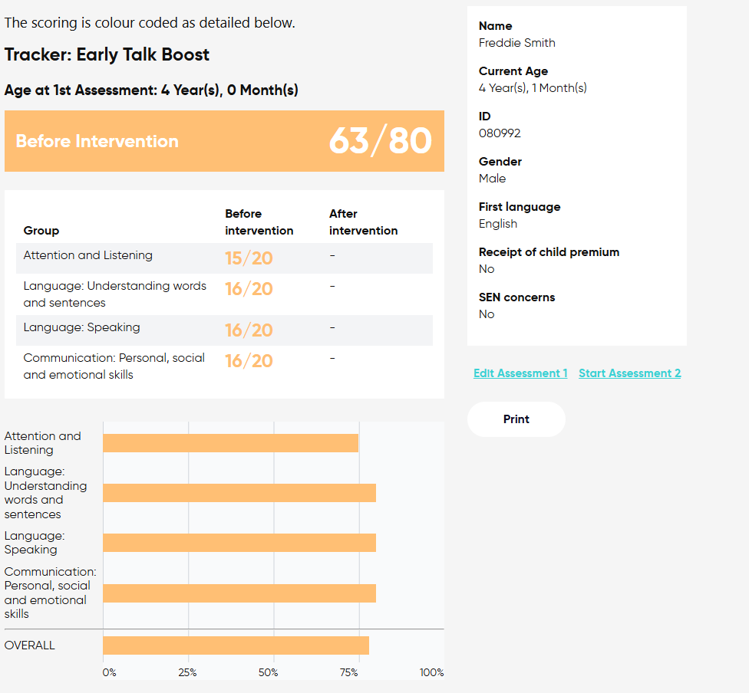
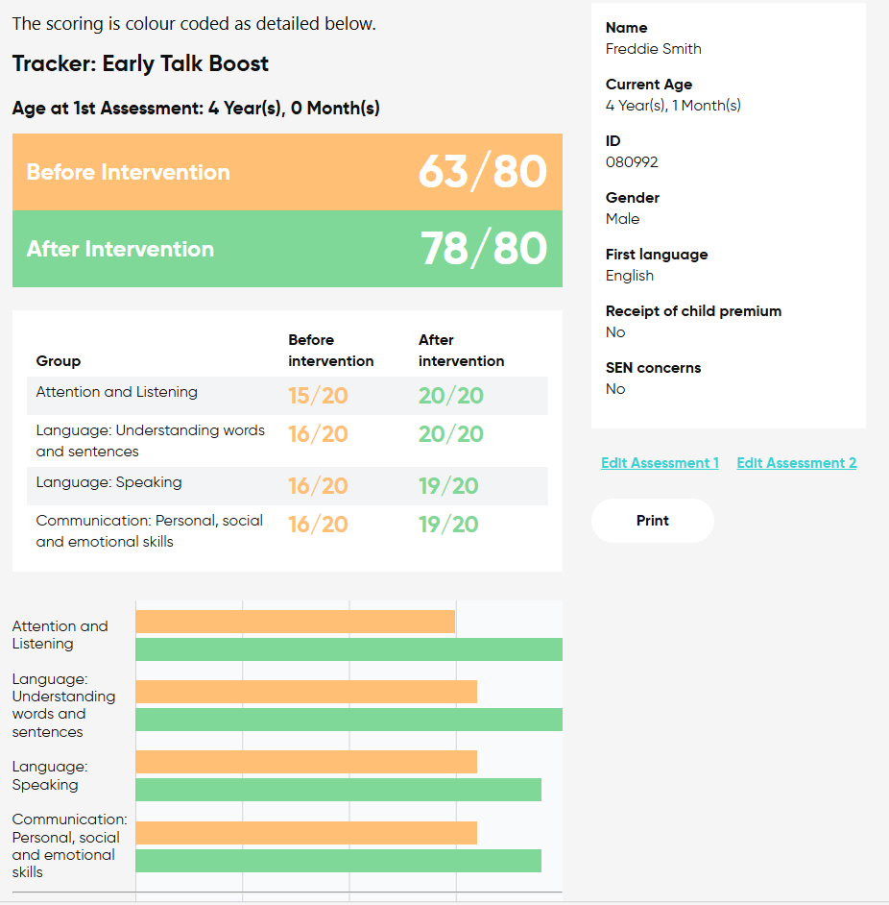
What does it look like?
Notes:
Make sure you keep a record of how many sessions have been attended

Slide 38
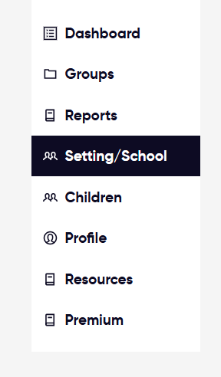
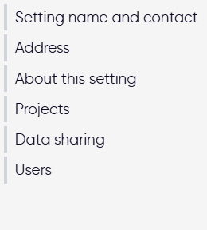
How to share with the local authority?
Notes:
As admin, select setting/school then data sharing, the admin is also responsible for adding new users

Slide 39
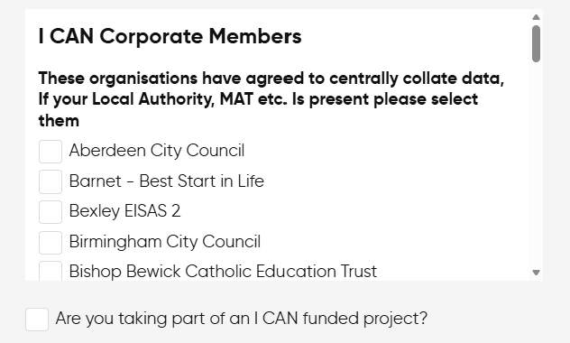
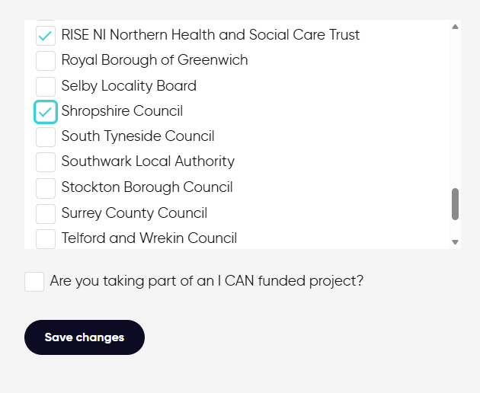
How to share with the local authority?
Speech and Language UK - data protection policy
Notes:
Go through the list and find Shropshire council and then save the changes
Why? This will show impact, and will provide a good insight into how this intervention is supporting children
Sharing with your local authority means it can be seen per setting- it does not show you the individual children
Link to data protection policy

Slide 40
Common problems
It is easy to put in date of birth or date of assessment incorrectly check these dates when submitting
If a child goes blue rather than red, amber or green they are out of range, likely because the date has been submitted incorrectly, simply go back in and edit
A child can only have one before and one after intervention on the tracker, so if delivering multiple interventions, you will need to edit the previous records
Once a child is added to a group, they can not be moved across with their tracking
info@speechandlanguage.org.uk

Slide 41
Support available on 25th of March 9am-10.30am
Speak to us if you would like to come to this session
Tracker Quick Starter Video
Early Talk Boost training 28th April and 6th May

Slide 42
Safeguarding.Audits@shropshire.gov.uk
Safeguarding Audits | Shropshire Learning Gateway

Slide 43
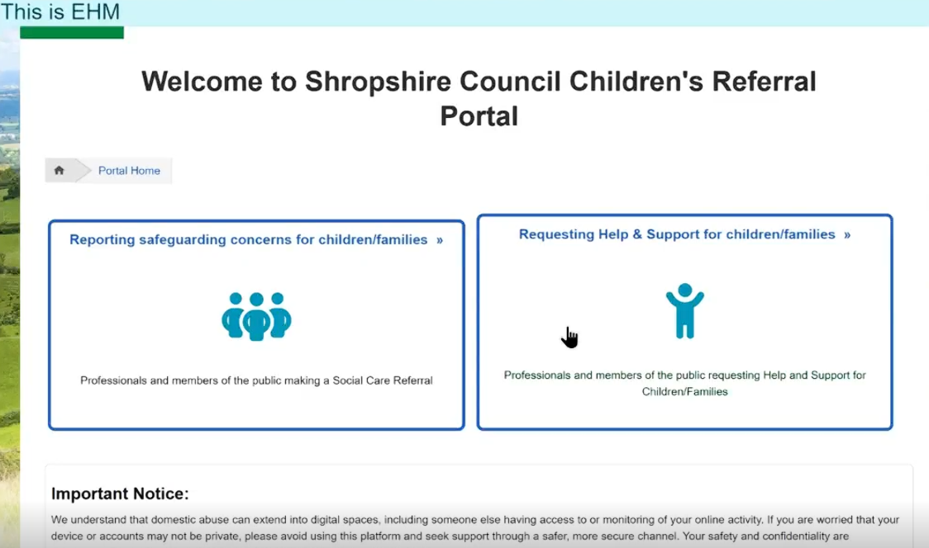
Children's Reporting Portal
Notes:
Starting 9th February there is the new children's portal, for making referrals,
If you have a concern that a child is currently or soon to be risk of harm you can still call FPOC and raise a concern, but this will replace the MARF, and you will be asked to complete the online form.
You can also use this to share information where you have a concern but you know it does not meet Child protection .

Slide 44


Safer Sleep
Early Years Statutory Framework states:
Sleeping children must be frequently checked to ensure that they are safe. Being safe includes ensuring that cot and bedding are in good condition and suitable for the child and that babies are placed to sleep in line with sleep safety guidelines.
Genevieve Meehan's parents are calling for 3 changes to protect babies/ children and early years worker:
To have Clear, statutory requirements on Safer Sleeping in Early Years Settings
To have a strengthened Ofsted inspection process in relation to sleeping arrangements
Mandatory CCTV in nurseries CCTV and digital devices in early years settings – Fill in form - Closes 20.03.26
Safer sleep overview | The Lullaby Trust
Baby safer sleep advice - Best Start in Life - NHS
Key safer sleep awareness
Safer-sleep-awareness-for-early-years-settings-booklet.pdf

Slide 45
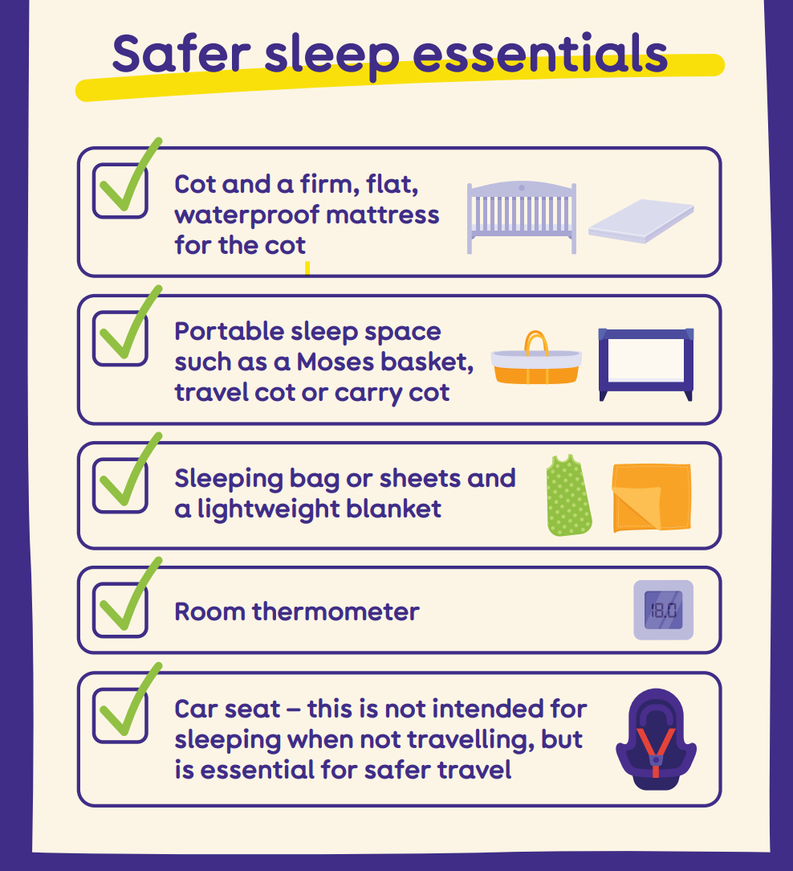
Safer Sleep
It is best practice that staff are present in the room with sleeping children to be alert to any changes in a child's condition, staff should complete visual checks every 5- 10 minutes- these checks should not be from a distance as they should include the child's breathing, their colour, sleep position and their general wellbeing. ​
The checks should record the time, any observations and actions taken and the name of the staff member completing the check.
DO:
Children placed on their backs
Use firm flat mattress – move child from car seat/pushchair
Keep bed/ cot clear
Use a sleeping bag or securely tucked in blankets
Keep room temperature between 16-20C
Complete sleep checks
Share information with parents about the child's sleep

