Slide 1

EBSA Card Sort Activity Description
This card sort activity has been developed by the Shropshire Educational Psychology Service to support young people who may be experiencing Emotionally Based School Avoidance (EBSA). The idea is to print, cut and laminate these cards (set of 40) to use with a young person (YP) to help identify their worries around college.
When working with a YP, you can select 20 of the 40 cards which apply to them based on your prior knowledge of the YP. Before starting the task, you will need to label one of your A3 sheets as ‘True About Me’ and the other as ‘Not True About Me’. Then, you can read out each card in turn to the YP at a slow pace and ask them to place each card under either label. Once this has been completed, you can take a photo of each sheet of paper. Next, label one sheet of A4 as ‘Top 5 Most Like Me’ and using the cards from ‘True About Me’, ask the young person to choose the top 5 which are most like them and place them accordingly. The other sheet of A4 should be labelled as ‘Top 5 I Would Most Like to Change’ and then ask the YP to choose 5 of their cards from the ‘Not True About Me’ to place under what they would most like to change. Once this has been completed, take a picture of both sheets.
The ‘Top 5 I Would Most Like to Change’ can be used to form the basis of your action plan. Parents, College and the young person can then work together to co-produce a plan which will inform how those changes can begin to be made.

Slide 2

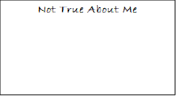
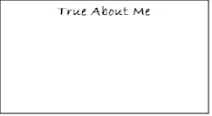
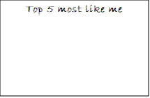
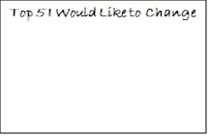
What you will need:
Set of 40 EBSA Cards
Four sheets of A3 Paper labelled:
Pen
Something to take a photo with

Slide 3
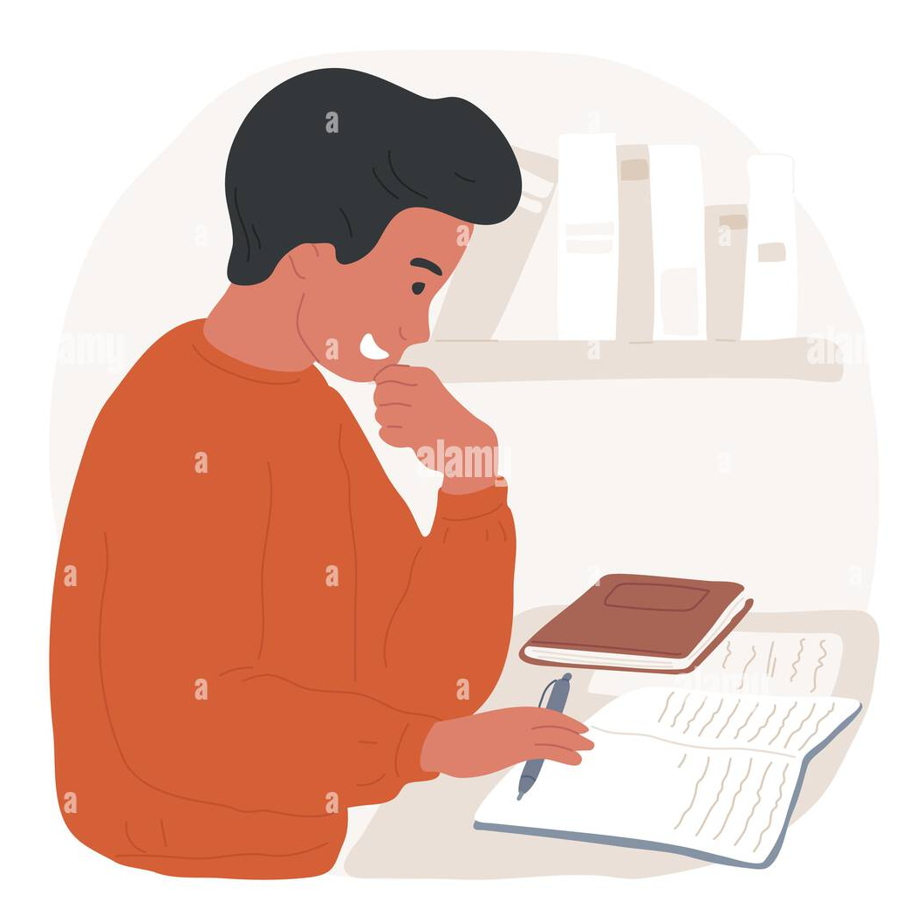
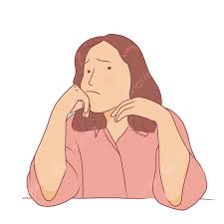

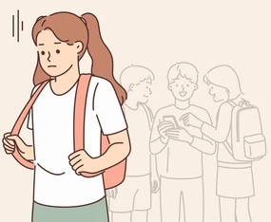






I feel worried at college
I wish I had friends
I don’t like it when it is noisy
I enjoy learning
I need lots of help with my learning
I enjoy attending college
I don’t like surprise changes in the day
I feel worried at home
ThePhoto by PhotoAuthor is licensed under CCYYSA.
ThePhoto by PhotoAuthor is licensed under CCYYSA.

Slide 4



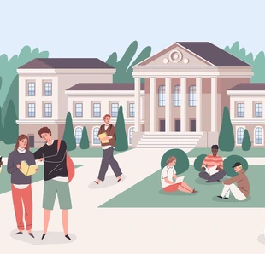






I would rather be at home than at college
I worry about breaktimes
I worry about getting to college
I have lots of friends
I don’t like it when it is too busy
I worry about lunchtime
I worry about home time
I like my tutors

Slide 5



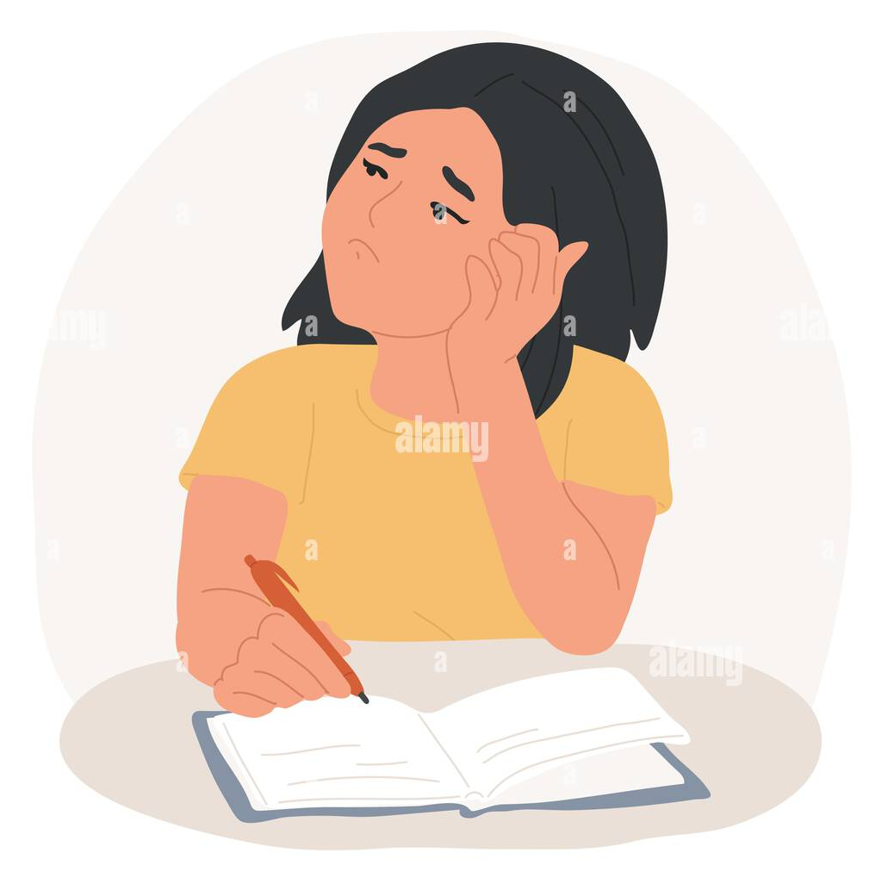

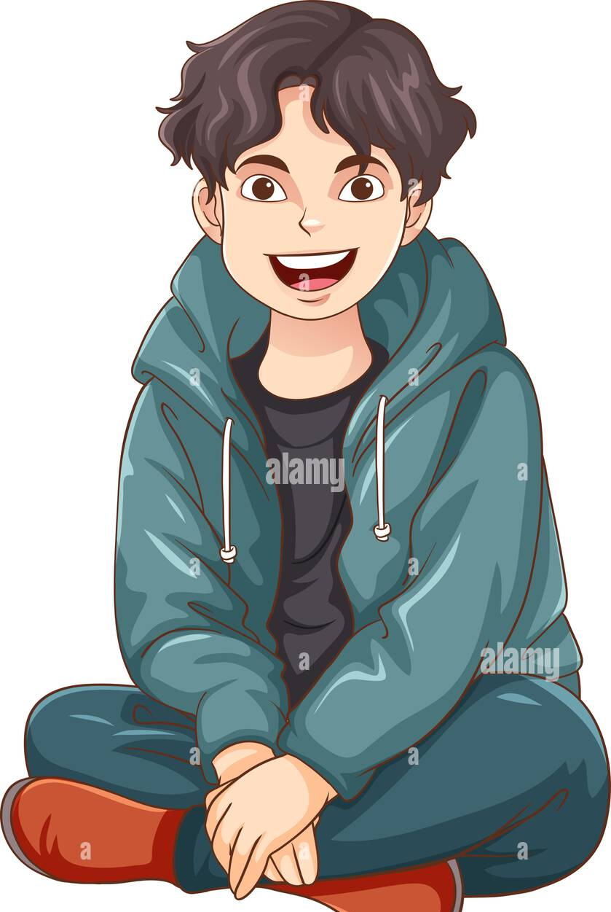




I worry about homework
I worry about college work
I don’t like my tutor
I can talk to my tutor
I can be myself at college
I feel safe in college
I have a special friend in college
I have lots of hobbies outside college

Slide 6
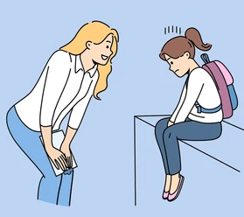
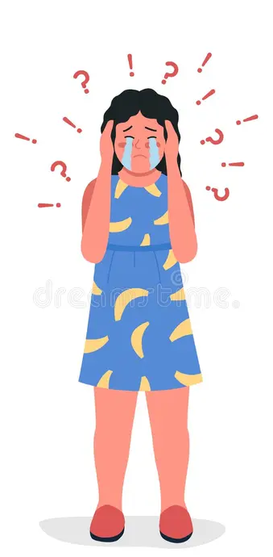

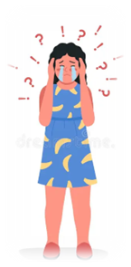
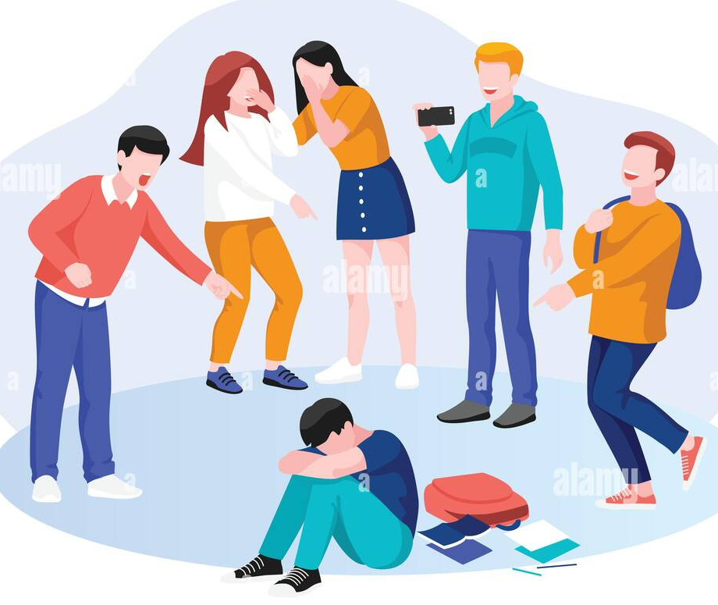



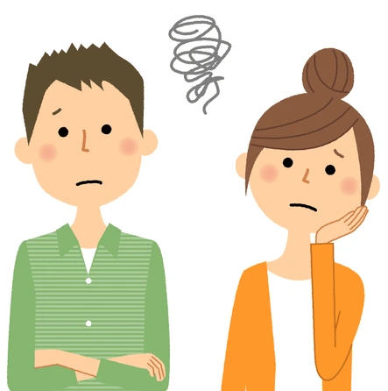
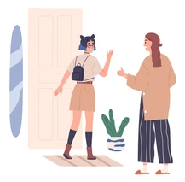

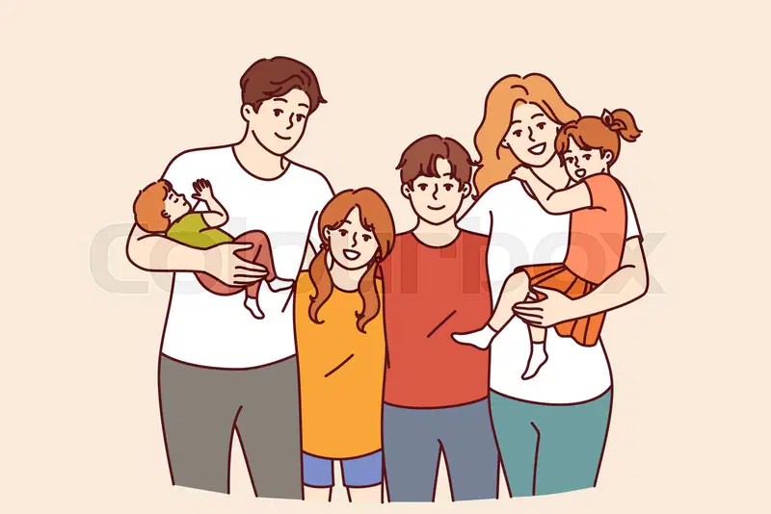

There is an adult I can talk to in college
I can talk about my feelings in college
I can talk about my feelings at home
The others are mean to me in college
I can’t talk about my feelings in college
I feel okay when I have to leave my parent/carers
There have been some changes in my family
My mum/dad need help

Slide 7



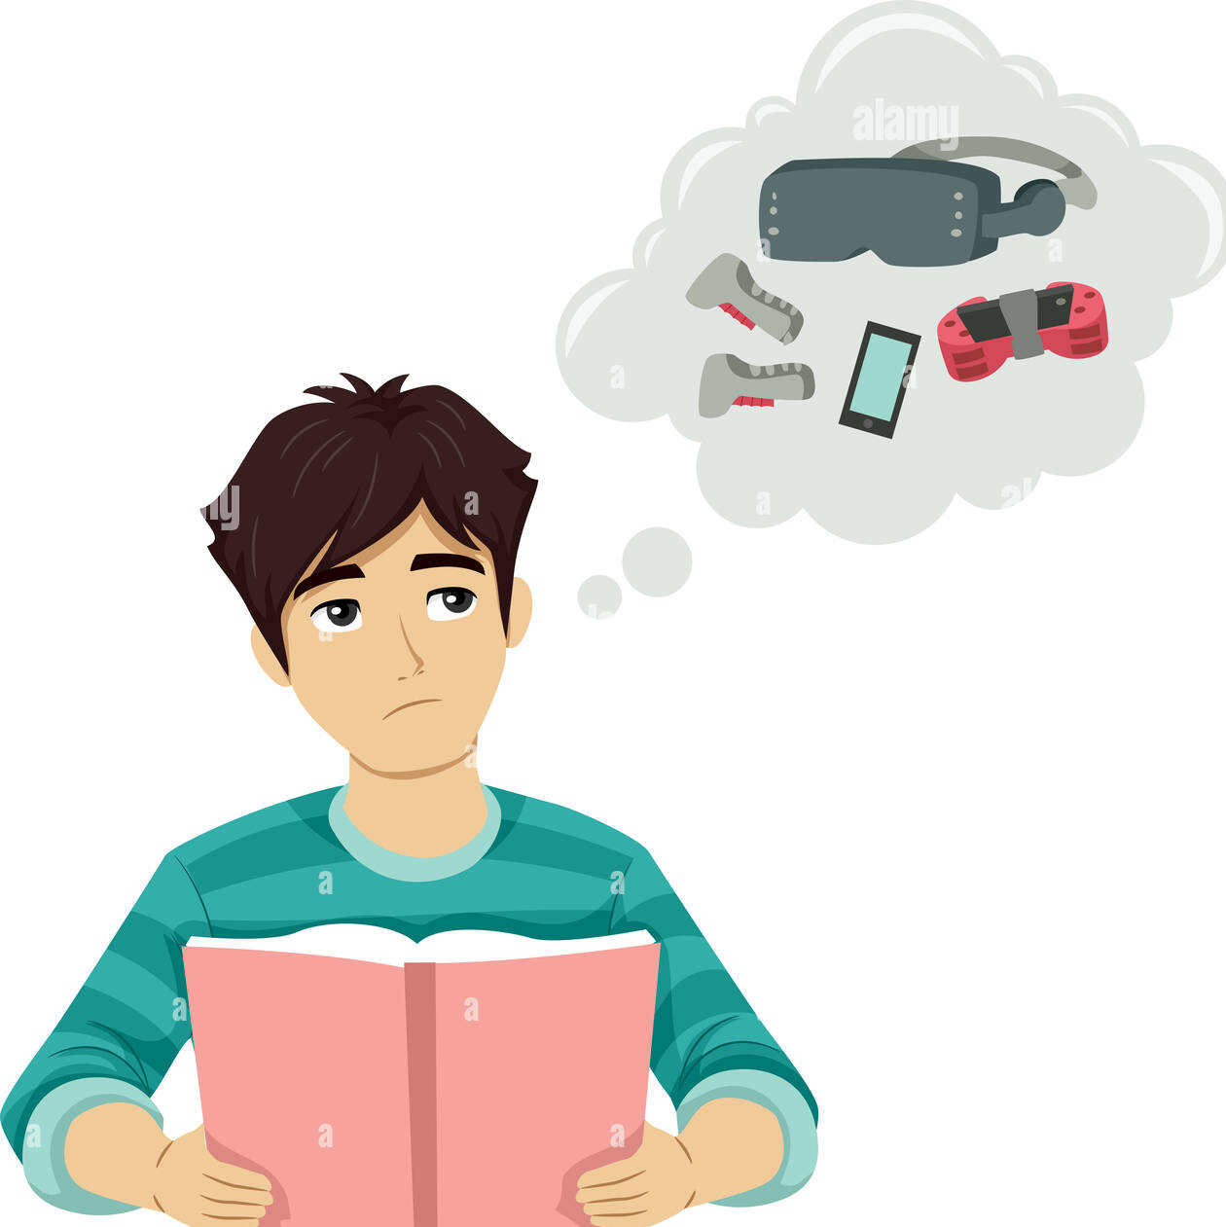
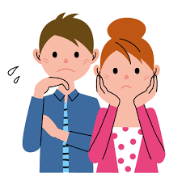
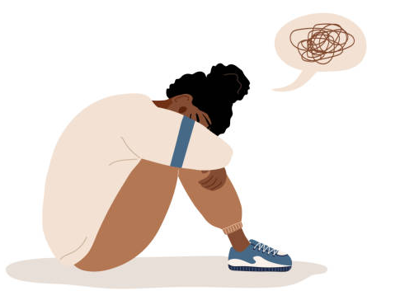
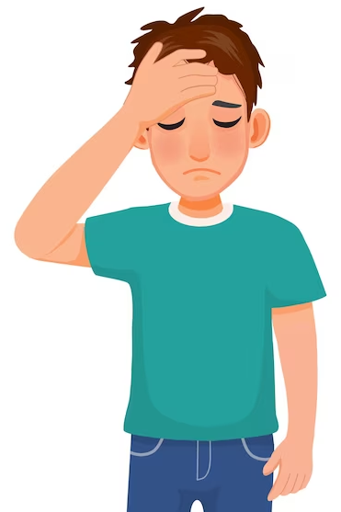


I know my family are okay when I am in college
I feel safe at home
I think a lot about Mum/Dad when I’m at college
I like being around other students
I miss my Mum/Dad when I’m at college
I worry about what’s happening at home when I’m at college
I feel Mum/Dad need me at home
I spend a lot of time with my family

