Slide 1
Key messages from Ofsted for PVI Settings and Childminders
Monday 31st March 2025
18:15 – 19:30
Beverley Jones
(Early Years Consultant)
A copy of these slides will be emailed to you.

Slide 2
Agenda:
Welcome and introductions
Setting the scene
Preparing for Ofsted
The learning walk
The curriculum
Emphasis on CL
Partnership working
CPD
Strengths and areas for development
Next steps
www.communityplaythings.co.uk

Slide 3
1. Welcome and introductions:
In the chat, please tell us your name and the name of your setting.
What-to-expect-in-the-EYFS-complete-
FINAL-16.09-compressed.pdf

Slide 4
2. Setting the scene: March 2025
Early years inspection handbook - GOV.UK
https://www.gov.uk/government/consultations/improving-the-way-ofsted-inspects-education

Slide 5
3. Preparing for Ofsted:
Development Matters - Non-statutory curriculum guidance for the early years foundation stage
Early years foundation stage (EYFS)
statutory framework - GOV.UK

Slide 6
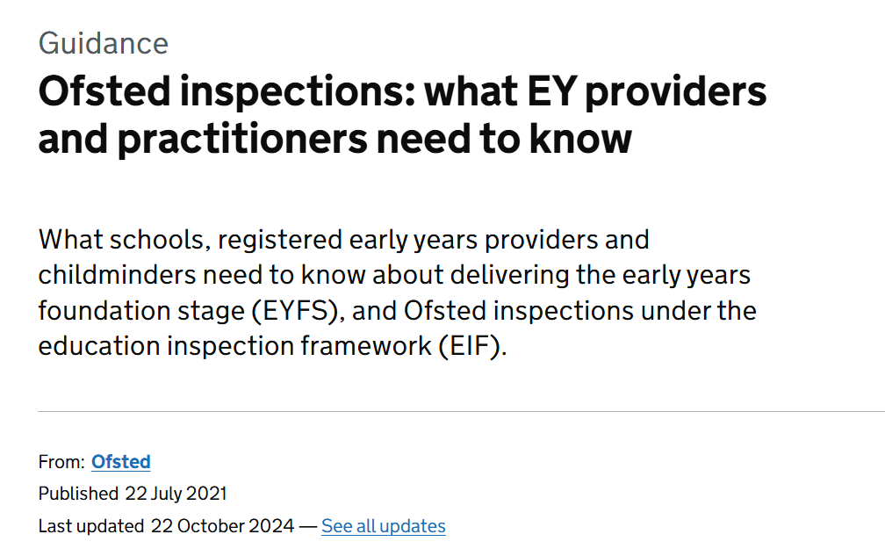
Ofsted | Shropshire Learning Gateway
Ofsted inspections: what EY providers and practitioners need to know - GOV.UK

Slide 7
4. The learning walk:
Explain how you organise your curriculum.
What do you want the children:
to know
be able to do
to understand
What should I expect from the learning walk? | Early years FAQs
Youtube clip

Slide 8
What are the children learning?
ABC Does

Slide 9
Physical development:
Development Matters - Non-statutory curriculum guidance for the early years foundation stage

Slide 10
Help for early years providers : Reducing paperwork

Slide 11
5. Curriculum:
“1.6 The educational programmes are high level curriculum summaries which set out what should be taught in settings for each area of learning. They must involve activities and experiences that enable children to learn and develop, as set out under each of the seven areas of learning.”
Early years foundation stage (EYFS) statutory framework - GOV.UK
“88. Inspectors must discuss with leaders and practitioners what they intend children to learn, know and do as a result of the EYFS curriculum they offer. They must follow this discussion through in their observations and discussions with children at play and staff interactions.”
Early years inspection handbook - GOV.UK

Slide 12
“Cultural capital is the essential knowledge that children need to prepare them for their future success … Some children arrive at an early years setting with different experiences from others, in their learning and play.”
Early years inspection handbook - GOV.UK

Slide 13
“185. Inspectors will evaluate how well:
leaders assure themselves that the setting’s curriculum (educational programmes) intentions are met and it is appropriately ambitious for the children it serves
leaders use additional funding for disadvantaged children, including the early years pupil premium where applicable, and measure its impact on disadvantaged children’s outcomes
practitioners ensure that the content and sequencing for each of the areas of learning are clear, allowing children to progress towards appropriately ambitious outcomes
children develop, consolidate and deepen their knowledge, understanding and skills across the areas of learning
the provider’s curriculum prepares children for their next stage.”
Early years inspection handbook - GOV.UK

Slide 14
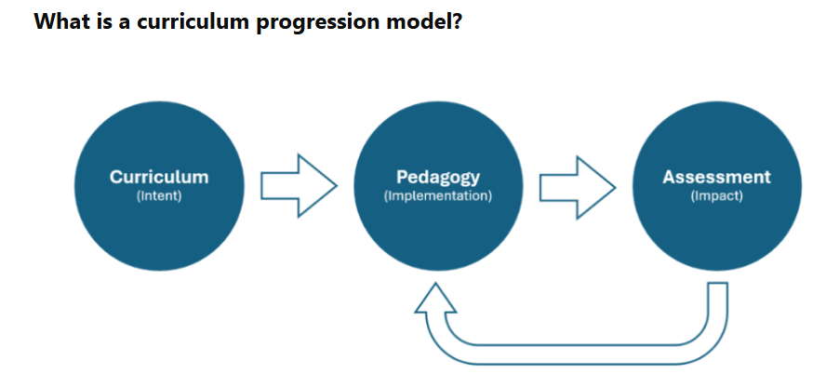
Help for early years providers : Curriculum planning

Slide 15
1. Teaching and learning based on children’s interests (weekly planning)
2. A regular cycle of learning of what you do to support children’s learning & development:
a) Key books, rhymes and songs (stay the same throughout the year)
b) Any regular activities in your setting
3. Core experiences and seasonal celebrations
4. Our curricular goals
c) Trips to add to the children’s experiences
An example from
Sheringham Nursery:
Youtube Clip
Do I need a curriculum map?

Slide 16
6. CL across all areas of learning
“94. When observing interactions between staff and children, inspectors should consider how well staff:
engage in dialogue with children
watch, listen and respond to children
model language well
read aloud and tell stories to children
encourage children to sing songs, nursery rhymes and musical games
encourage children to express their thoughts and use new words …”
Early years inspection handbook - GOV.UK
EEF blog: The ShREC approach – 4 evidence-informed strategies… | EEF

Slide 17
Part 4 (settings) - Early years curriculum:
How we look at communication and language on inspection - YouTube

Slide 19
7. Partnership working:
Research shows that involving parents and carers in their children’s learning is the most important factor in enabling some children to do well regardless of background.
Help for early years providers : Working in partnership with parents and carers
“Parent partnership is exemplary. Parents are very involved in every stage of their child’s
learning. They discuss starting points and learning needs in detail at every stage of their
child’s transition through nursery … [Parents] state they are very well-informed and share in
learning activities…”
“Parents refer to the childminder as being like a member of the ‘extended family’… They say
that [the childminder and her assistant] both work really well together and offer unparalleled
levels of support for the children and the family as a whole…”

Slide 20
What-to-expect-in-the-EYFS-complete-FINAL-16.09-compressed.pdf

Slide 21
8. CPD:
“1.19 All children deserve high quality early education and care. This requires a quality workforce. A well-trained, skilled team of practitioners can help every child achieve the best possible educational outcomes…”
EYFS statutory framework for group and school-based providers
“1.14 All children deserve high-quality early education and care. This requires a quality workforce. A well-trained, skilled childminder can help every child achieve the best possible educational outcomes…”
EYFS statutory framework for childminders

Slide 22
Help for early years providers : Training, qualifications, support and guidance
Help for early years providers : Training, qualifications, support and guidance
Thrive Together Early Years Stronger Practice Hub (West Midlands) | Stronger Practice Hubs

Slide 23
9. Strengths & areas for development:
“83. Leaders and managers of settings should have an accurate view of the quality of their provision and know what to improve. They do not need to produce a written self-evaluation but should be prepared to discuss the quality of education and care they provide – and how well they meet the needs of the children – with the inspector. Inspectors will consider how well leaders and managers evaluate their provision and know how they can improve it or maintain its high standards.”
Early years inspection handbook - GOV.UK

Slide 24
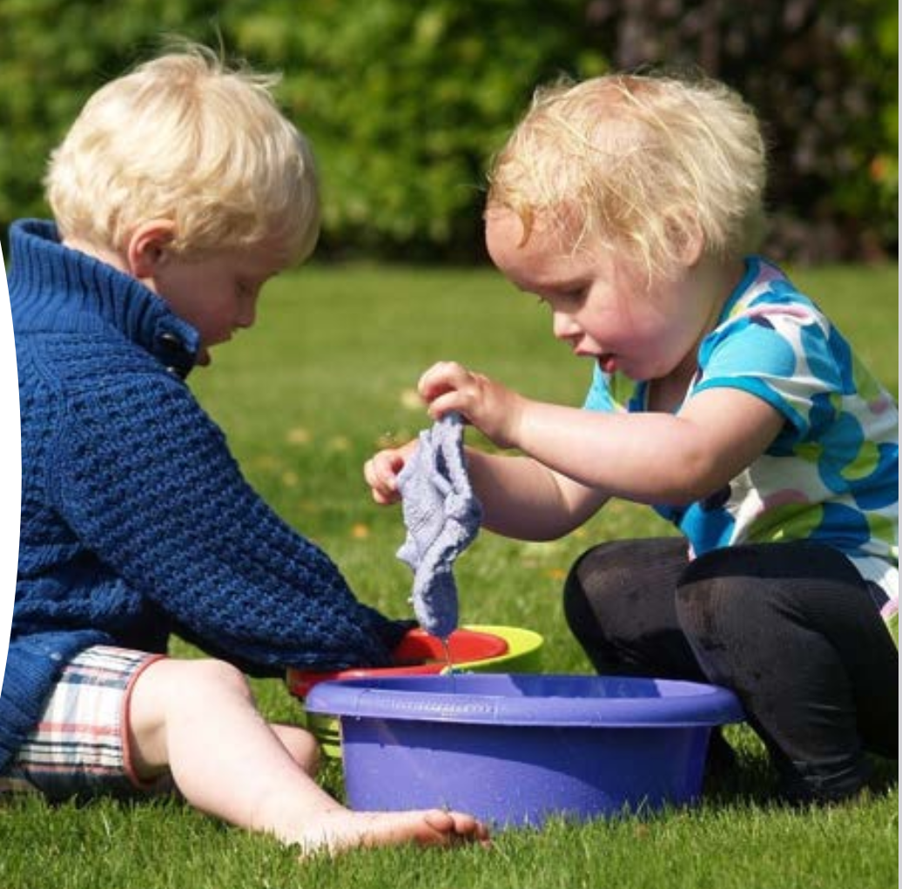
10. Next steps?
Ask your staff:
-to tell each other the story of a child’s progress since starting at your setting.
-why have they planned that particular activity? What learning is taking place?
What-to-expect-in-the-EYFS-complete-
FINAL-16.09-compressed.pdf

Slide 25
Ofsted | Shropshire Learning Gateway
Find an Ofsted inspection report

Slide 26
Screening tool to screen children from age of 2 on
their understanding and speech sounds.
CPD Schedule and Booking Information 2024 - 2025 | Shropshire Learning Gateway
Child's Progress checker - Speech & Language UK

Slide 27
Future CPD:
Developing vocabulary through sharing books with under 3’s (online)
Tuesday 8th April 2025 13:30 – 15:30
Developing vocabulary through sharing books with 3–4-year-olds (online)
Thursday 10th April 2025 13:30 – 15:30
Key messages on the curriculum from Ofsted for PVI settings and childminders (online)
Monday 30 June 2025 18:15 – 19:45
CPD Schedule and Booking Information 2024 - 2025 | Shropshire Learning Gateway

Slide 28
Early years inspection handbook - GOV.UK
“186. Teaching is a broad term that covers the many different ways in which adults help young children learn. It includes their interactions with children during planned and child-initiated play and activities, communicating and modelling language, showing, explaining, demonstrating, exploring ideas, encouraging, questioning, recalling, providing a narrative for what they are doing, facilitating and setting challenges. It takes account of the equipment that adults provide and the attention given to the physical environment, as well as the structure and routines of the day that establish expectations. Integral to teaching is how practitioners assess what children know, understand and can do, as well as taking account of their interests and dispositions to learn (characteristics of effective learning), and how practitioners use this information to plan children’s next steps in learning and to monitor their progress.”

Slide 29
Non-chargeable visit:
If you are expecting Ofsted within the next 6 months, please contact Beverley Jones to arrange an EYFS visit to your setting. (Beverley.jones@shropshire.gov.uk)

Slide 30
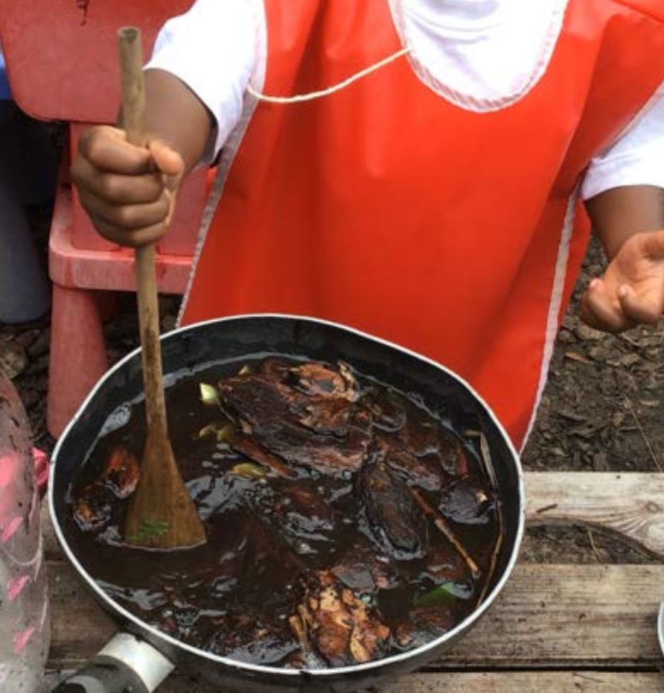
Finally …
What-to-expect-in-the-EYFS-complete-
FINAL-16.09-compressed.pdf
What is it like to be a child at your setting?
Beverley.jones@shropshire.gov.uk

