Slide 1
Ofsted: is your curriculum fit for purpose?
Tuesday 9th April 2024
6:30pm – 8pm
Beverley Jones (Early Years Consultant)
Alison Rae (Early Years Adviser)

Slide 2
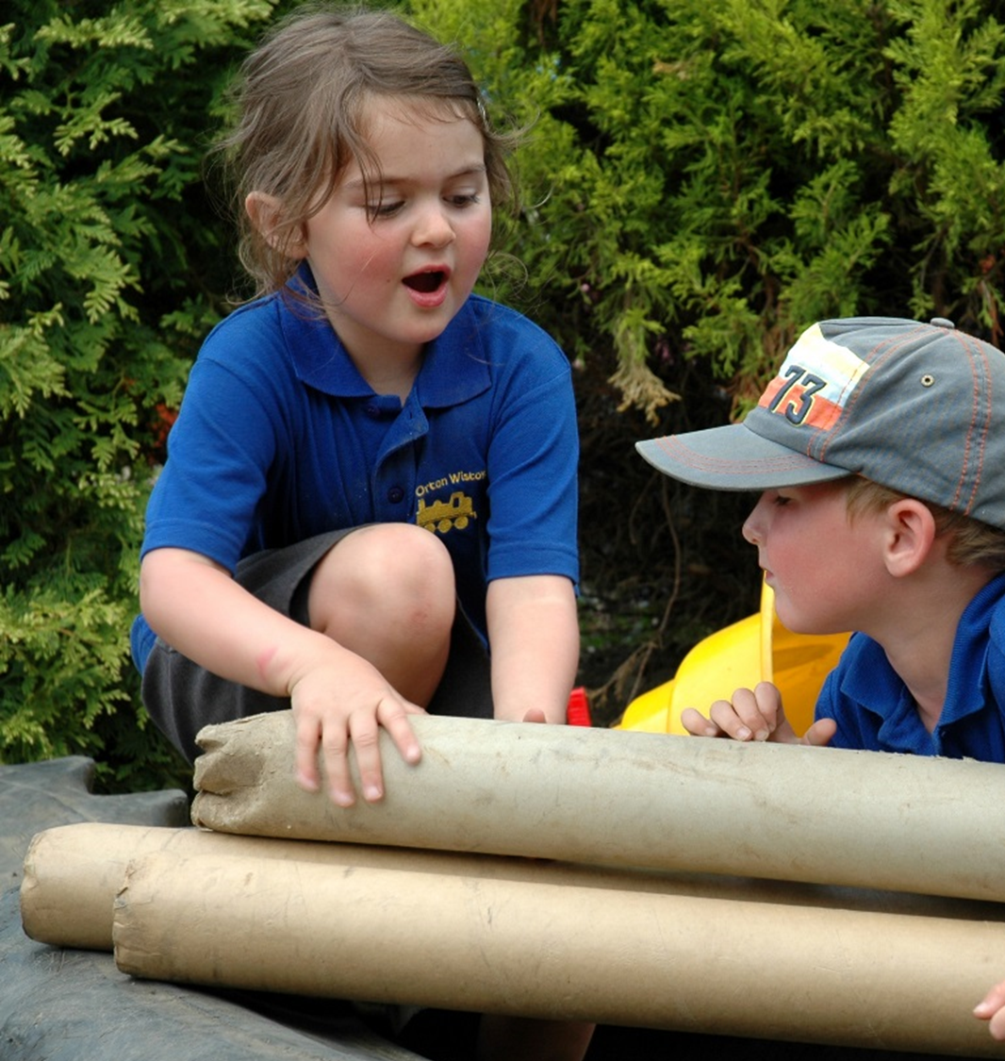
Objective:
You will be confident in developing and designing a curriculum that is fit for purpose.

Slide 3
The curriculum:
“A curriculum is what you want the children to learn in the time they are with you.”
Curriculum planning - Help for early years providers - GOV.UK (education.gov.uk)
“This definition uses the concepts of ‘intent’, ‘implementation’ and ‘impact’ to recognise that the curriculum passes through different states: it is conceived, taught and experienced. Leaders and teachers design, structure and sequence a curriculum, which is then implemented through classroom teaching. The end result of a good, well-taught curriculum is that pupils know more and are able to do more.”
Inspecting the curriculum (publishing.service.gov.uk)
(2019:p.3)

Slide 4
Sticky-knowledge
PowerPoint Presentation (christchurchprimarynewark.co.uk)

Slide 5
Recommendations in Shropshire (2023):
“Implement a well-planned curriculum to ensure that activities are developmentally appropriate and build on what children already know and can do, to help them make the best possible progress from their individual starting points
Ensure all staff have a clear understanding of the curriculum and children's next steps for learning, so that their teaching is consistently focused on what children need to learn to prepare them for the next stage in their education.”
“The early years curriculum does not clearly set out the knowledge, skills and vocabulary that children will learn in and across the Nursery and Reception classes. Consequently, learning activities do not fit into a well-ordered sequence of learning. The school should sequentially map out the knowledge, skills vocabulary that children will learn in and across the Nursery and Reception classes.”
Find an Ofsted inspection report

Slide 6
Putting the EYFS Curriculum into Practice: Julian Grenier's 2023 keynote at Newham's EY Conference (youtube.com)

Slide 9
Child development:
We have an overall picture of where we are heading, but we can’t just observe and make an instant judgement and find the next step on the tracker or drop-down menu.
Children’s learning and development doesn’t just develop and ‘unfold’ with us tracking and celebrating each stage.
The adults are really important in supporting the conversations and play.
We need a mixed approach to early years education: a ‘Mongrel curriculum’.
Putting the EYFS Curriculum into Practice: Julian Grenier's 2023 keynote at Newham's EY Conference (youtube.com)

Slide 10
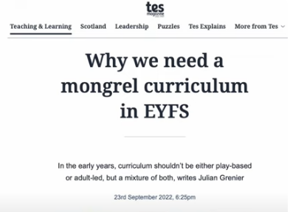
Mongrel mixed curriculum:
Putting the EYFS Curriculum into Practice: Julian Grenier's 2023 keynote at Newham's EY Conference (youtube.com)

Slide 11
A continuum of approaches:
Learning, Playing and Interacting - Good practice in the Early Years Foundation Stage
(earlyyearsmatters.co.uk) p.6

Slide 12
Where to start?
“The educational programmes are high level curriculum summaries which set out what should be taught in settings for each area. They must involve activities and experiences that enable children to learn and develop, as set out under each of the areas of learning.”
EYFS statutory framework
(2024: p. 10)

Slide 13
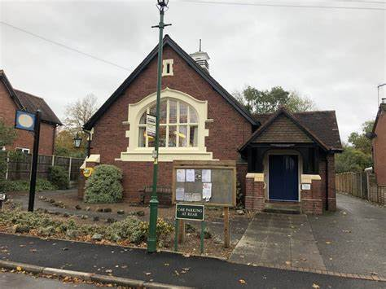
Knowing your children and their families:
Cultural Capital
“The curriculum is a top-level plan of everything the early years setting wants the children to learn.” (2023:p.9)

Slide 14
Curriculum planning:
You should always start with the early years foundation stage (EYFS) framework. It contains educational programmes that sit under 7 areas of learning. These are high-level curriculum summaries that you must follow and work into a rich curriculum that meets the needs of the children.
From there, break down those high-level curriculum summaries into smaller steps. Decide what you want children to learn, the activities you want to do with them and how your setting can support their learning.
Childminders or nursery leaders (working with their staff) should decide how to implement these activities and experiences, so the children can progress in all the areas of learning. You should evaluate how well the curriculum works, checking what children know and can do as they move through the EYFS.
Curriculum planning - Help for early years providers - GOV.UK (education.gov.uk)

Slide 15
Your curriculum overview:
Important consideration
e.g. through themes, ITMP
1. Teaching and learning based on children’s interests (weekly planning)
2. A regular cycle of learning of what you do to support children’s learning & development:
a) Key books, rhymes and songs (stay the same throughout the year)
b) Any regular activities in your setting
3. Core experiences and seasonal celebrations
4. Our curricular goals
c) Trips to add to the children’s experiences
What you regularly
do to support children’s
learning and
development.
Use DM or B25M
as a guide. Write what is important to your setting.
Experiences, celebrations and seasonal experiences
These should
mainly stay the
same each year
Regular activities
in your setting
Where do you children
go to add to their
experiences?

Slide 16
Teaching and learning based on children’s interests (weekly planning)
Important consideration
Themes
In the moment planning
“As you make changes to your curriculum consider what you want children to learn first and plan opportunities for them to achieve this.”
Understanding the world - Help for early years providers - GOV.UK (education.gov.uk)

Slide 17
Planning cycle example:
Provide regular opportunities
to practise and repeat their
learning. Some children will need
extra help others additional
experiences to deepen their learning.
The big picture: what you want
children to know and be able to do
(curriculum overview).
Gather information
Consider & think
Plan
Act
Review
(Observe and assess)
Notice what children know and what can they
already do. What do you want them to
learn next?
Organise activities or
equipment to maximise
learning.
Help children to learn – adult
Interactions, learning
environment, specific
vocabulary
SNSCC-Curriculum-Policy-update.pdf (sheringham-nur.org.uk)

Slide 18
2. A regular cycle of learning of what you do to support children’s learning & development:
a) Key books, rhymes and songs (stay the same each year)
These should mainly stay the
same throughout the year.
Connection and Core Stories – How Storytelling can Support Settling | Stronger Practice Hubs
b) Any regular activities in your setting
Regular activities in your setting.
c) Trips to add to the children’s experiences
Where do your children
go to add to their
experiences?
What activities or trips do you do regularly to support your children’s learning & development?

Slide 19
To support you …
Books and Rhymes 2 Year Olds - Sheringham Nursery School (sheringham-nur.org.uk)
Books and Rhymes 3-4 Year Olds - Sheringham Nursery School (sheringham-nur.org.uk)
https://www.booktrust.org.uk/booklists
What does 'cultural capital' mean for early years? (youtube.com)
What is Cultural Capital in the EYFS? | Famly

Slide 20
3. Core experiences and seasonal celebrations.
Cultural diversity | Shropshire Council
Experiences, celebrations and seasonal experiences
Understanding the world –
Help for early years providers - GOV.UK (education.gov.uk)
draft-ey-booklists-5.pdf (shropshire.gov.uk)

Slide 21
Your curriculum overview:
Important consideration
e.g. through themes, ITMP
1. Teaching and learning based on children’s interests (weekly planning)
2. A regular cycle of learning of what you do to support children’s learning & development:
a) Key books, rhymes and songs (stay the same throughout the year)
b) Any regular activities in your setting
3. Core experiences and seasonal celebrations
4. Our curricular goals
c) Trips to add to the children’s experiences
What you regularly
do to support children’s
learning and
development.
Use DM or B25M
as a guide. Write what is important to your setting.
Experiences, celebrations and seasonal experiences
These should
mainly stay the
same each year
Regular activities
in your setting
Where do you children
go to add to their
experiences?

Slide 22
*An example of a curricular overview:
*Curriculum and assessment policy
(Working draft, Autumn 2021)
[Online]
1.Teaching and learning based on children’s interests.
2. A regular cycle of learning to support children’s care, L&D:
a) Songs, rhymes and key books
b) Wellie Wednesday & Diddy Dance
c) Trip on the bus to visit Shrewsbury Museum.
3. Planting & growing & vegetables.
4. Curricular goals
The Chestnuts’ Nursery
(2–4-year-olds)

Slide 23
4. Curricular goals
Write down what is important to your setting.

Slide 24
Do I need a curriculum map? | Early years FAQs - YouTube

Slide 25
The role of the adult:
“The quality of the language which children hear and engage with matters more than the quantity … Children need to hear many different words and to hear unusual as well as everyday words.”
“Adult-child interactions are the ‘engine-room’ of language development. The physical environment and resources we provide are the fuel which lights the fire.”
Grenier, J. & Vollans, C. (2023)
Putting the EYFS curriculum into practice

Slide 26
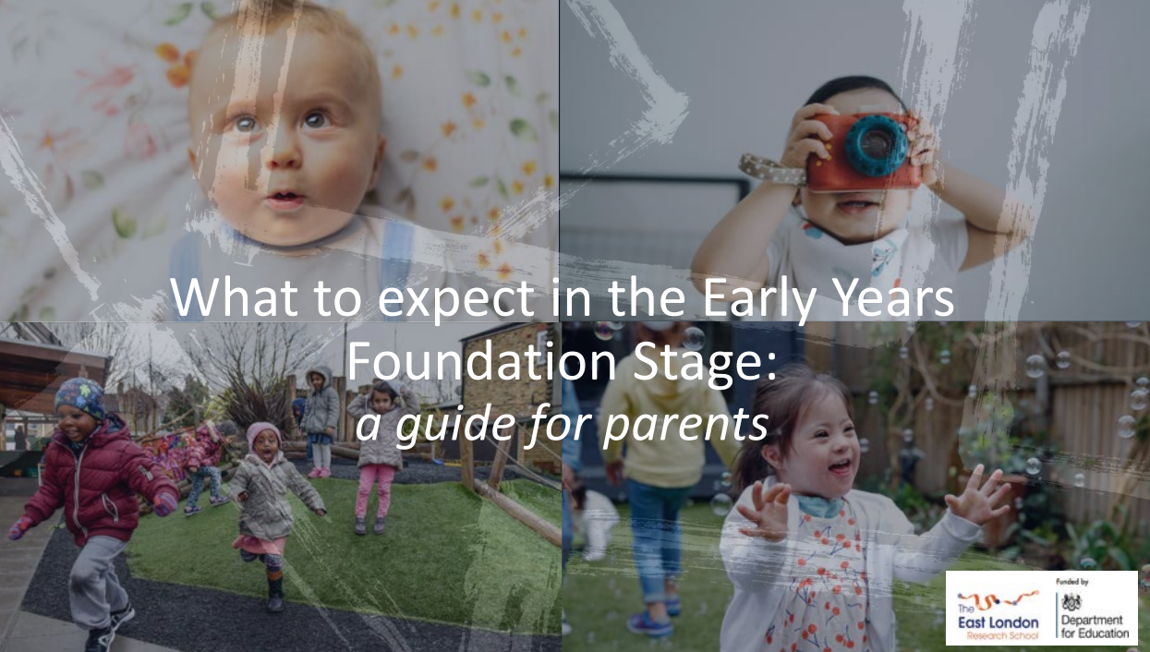
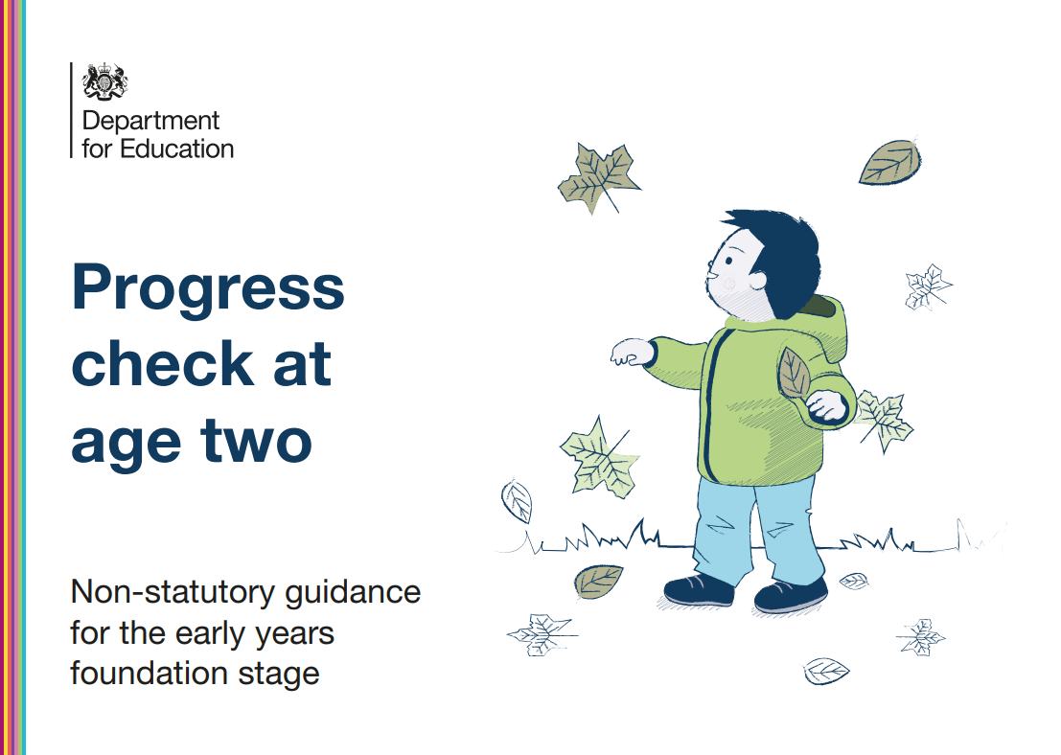
Tools to help you:
Curriculum planning - Help for early years providers - GOV.UK (education.gov.uk)

Slide 27
On reflection…
You will be confident in developing and designing a curriculum that is fit for purpose.

Slide 28
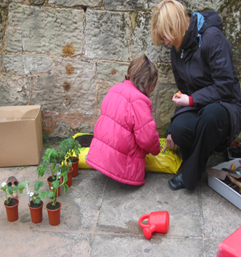
And finally …
“Every child needs a well-planned, high-quality early education which provides them with the knowledge, vocabulary and skills they need for a successful future in school. This is important to all children and especially so for those children growing up in disadvantaged circumstances.”
Grenier, J. & Vollans, C.
Putting the EYFS curriculum into practice
(2023:p.7-8)

