Slide 1
Early Years Network Meeting (All settings 0-4 years)
Tuesday 23rd September 2025
19:00 – 20:30

Slide 2
Agenda:
Welcome (AR)
Setting Development Groups (AR)
Provider Agreement (DS)
Safeguarding Update (CP)
Ofsted’s Early Years’ inspection toolkit (BJ)
Updates on the SLG on your phone (BJ)
AOB (AR)
Dates of next meetings (AR)
Notes:
AR Add 15 minute break / networking?

Slide 3
Setting Development Groups:

Slide 4
Overview:
General Reminders
Provider Agreements launch, activity and feedback

Slide 5
General Reminders
Interim Headcounts- Please submit them by the deadlines set by the funding team. These are set out on the Provider portal home page and EY & Childcare Providers teams site. If you don’t have access, let me know and we can add you.
Reminder: When completing 2 year old headcount please ensure you are entering hours in correct places. Ie 24U or working family (~500 errors). Guidance circulated by SJ
Please ensure setting policies are up to date (Audits soon)

Slide 6

Early Years Provider Agreement:
Statutory obligation between providers and LA’s
Mirrors DfE Statutory guidance
In place to support settings and providers
Updated annually (Addendums if necessary)
Peer reviewed within LA
Quality Assured by Shropshire Partnership Board members

Slide 7

Early Years Provider Agreement:
With you, rather than to you
Please spend 15 minutes reviewing and discussing in groups
Feedback and discussion is welcome

Slide 8
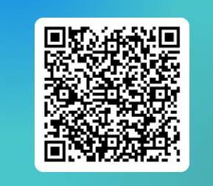
Table 1: Section 1 and 2
Table 2: Section 3 and 4
Table 3: Section 5 and 6
Table 4: Section 7 and 8
Table 5: Section 9 and 10
Table 6: Section 11 and 12
SCAN ME!

Slide 9
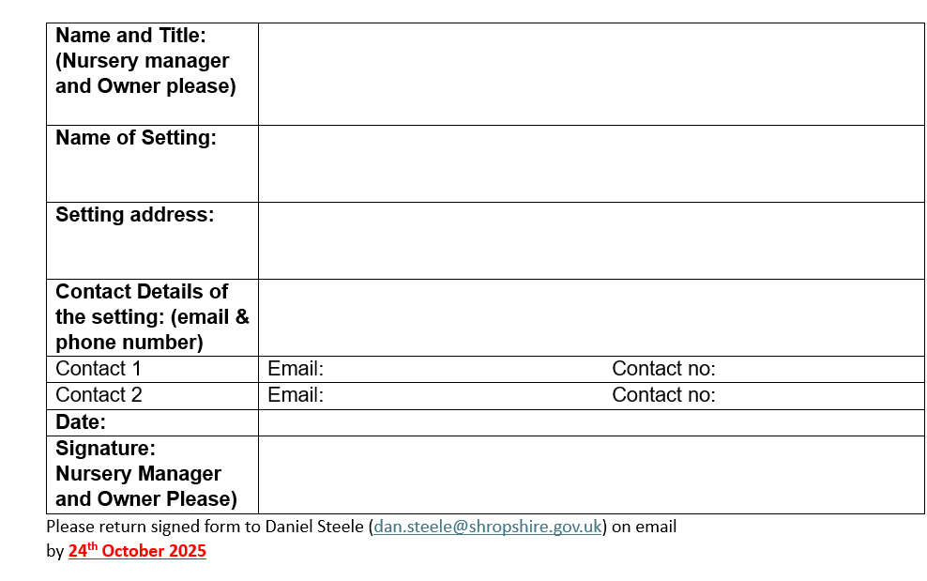
Early Years Provider Agreement:

Slide 10

Early Years Provider Agreement:
Shared by Friday 26th September 2025 with all settings (SLG)
Links to SLG page will be sent out
Please review, sign and return to us by email by 24th October 2025
No Signed Agreement = No funding (DfE Ruling)
If you have any questions or queries, Dan.Steele@shropshire.gov.uk

Slide 11
Safeguarding Update:
Changes to Operation Encompass Notifications
Information on Shropshire Learning Gateway has been updated
Operation Encompass | Shropshire Learning Gateway
Raising awareness in safeguarding and protecting children training
Reminder that all staff need to complete this training every 2 years so anyone that has done their training prior to end of September 2024 will need to complete it ASAP.

Slide 12
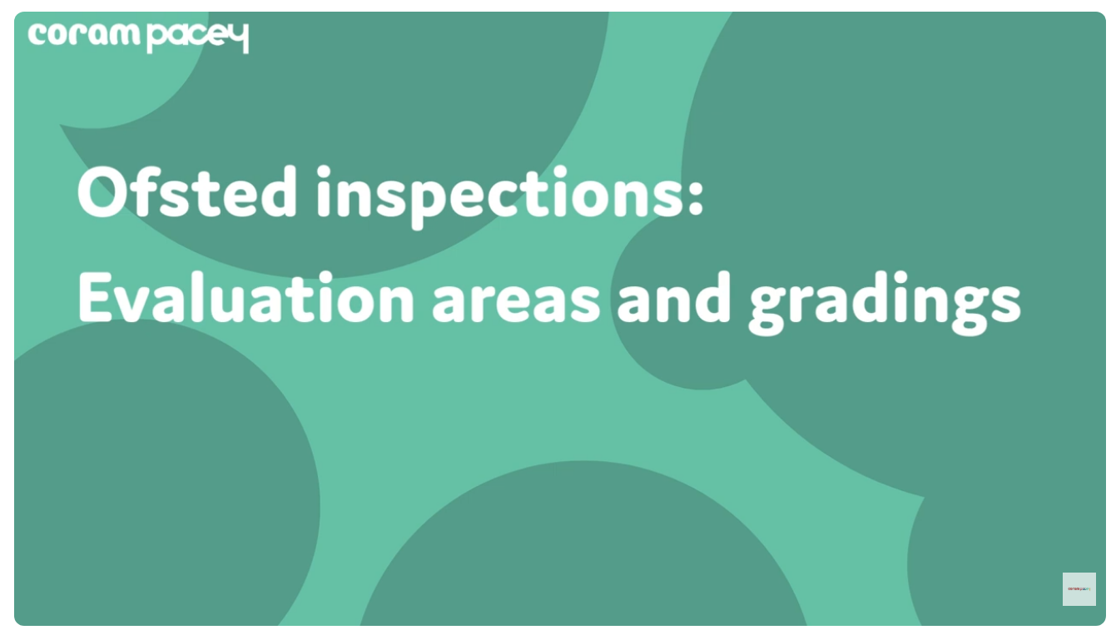
Changes from 10th November 2025:
Ofsted inspections: evaluation areas and gradings

Slide 13

Changes from 10th November 2025:
Explainer: The Early years inspection toolkit

Slide 14
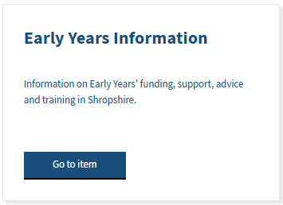
Recent updates on the SLG:
https://www.shropshirelg.net

Slide 15
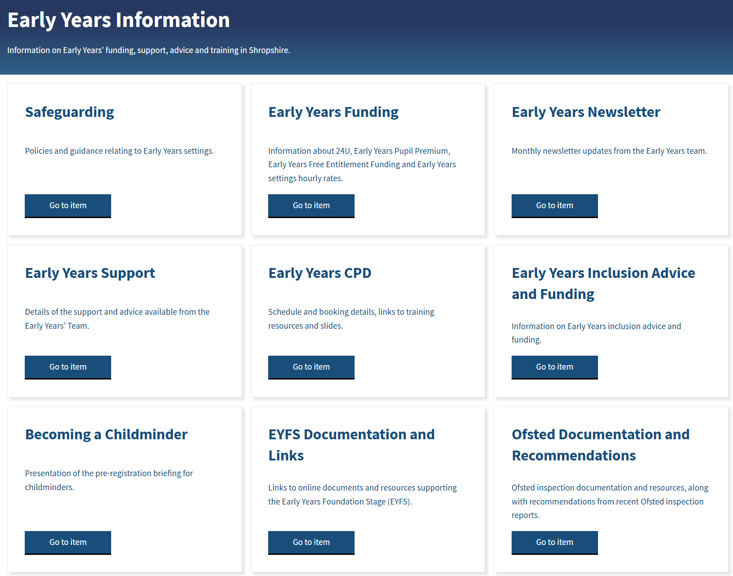

Slide 16
Dates for EY Network Meetings 2025 - 2026:
-Tuesday 4th November 2025 (online)
09:30 – 10:30 or 7pm – 8pm
-Tuesday 10th February 2026 (online)
09:30 – 10:30 or 7pm – 8pm
-Wednesday 18th March 2026 (face-to-face)
7pm – 8:30pm (Venue in Shrewsbury TBC)
-Wednesday 13th May 2026 (online)
09:30 – 10:30 or 7pm – 8pm
-Tuesday 14th July 2026 (face-to-face)
7pm – 8:30pm (Venue in Shrewsbury TBC)
CPD Schedule and Booking Information 2024 - 2025 | Shropshire Learning Gateway

