Slide 1

A Know How Guide: working with 2-year-olds (September 2025)
Section | Page(s)
Introduction | 2
The emotional environment and the key person | 3 - 5
The indoor environment | 6 - 7
The outdoor environment | 8 - 9
The characteristics of effective learning | 10
The areas of learning & development | 11
The prime areas - personal, social and emotional development | 12 - 16
- communication and language | 17 - 19
- physical development | 20 - 23
Assessment - observational checkpoints | 24 - 25
- Early communication screening tool | 26
- Early speech and language development chart | 27
- Progress check at 2 | 28
Safeguarding and welfare requirements | 29 - 30
References and further reading | 31 - 32
1

Slide 2



Introduction:
“Being two is not easy. At times you feel big and strong. You declare your independence in all kinds of ways; you want to be respected and given space. Other times you feel small and vulnerable; the world looms large and scary. You want to be held and hugged and treated like the baby you used to be. Sometimes your special grown ups just don’t get, and then you fly apart!”
A good place to be Two
Rapid brain development in two-year-old children creates a critical period for growth, with a million neural connections forming every second. Supporting children through this stage via partnerships between parents and early education practitioners can have lifelong benefits on learning and enjoyment. Early intervention focusing on social and emotional development is shown to improve mental health, education, and employment outcomes, emphasizing
the importance of high-quality early years education for reducing inequality.
This booklet brings together information from a range of sources, to support you in providing for some children, the first significant relationships outside of the family home. Within these relationships the children will flourish and learn, becoming resilient life-long learners.
2yo_toolkit.pdf
2

Slide 3
The emotional environment:
Area to reflect upon | What would it look like? | Pause for thought
Attachment: Providing a secure base to explore from and a safe haven to retreat to. 2yo_toolkit.pdf | The key person (KP) is introduced to the child and family over time and a 3-way relationship begins. When the parent carer leaves the child may demonstrate separation anxiety but can be soothed by the KP. When the child has settled in, they are willing to explore the environment for brief periods of time, without the KP. The child can explore and take risks in their play and learning and check in with the KP when needed. The KP holds the key children in mind and is able to articulate and tune in to their individual personalities. The KP knows when to step in and when to withdraw from the child’s play and learning. The child knows that their KP can be relied upon to be responsive. | Do we allow plenty of opportunities for the parent carer and child to become familiar with and build a relationship with the KP? Do we recognise that each child’s separation anxiety can be co-regulated by an attuned adult and allow for that? Do we recognise the importance of the welcome / handover and reunion at the end of the session? Does the environment provide cosy relaxing places where the children can go to be alone or with adults? Do we observe and recognise the importance of each child using their KP as a safe haven, supporting the child’s resilience and self-esteem? Do we allow for each child to move between dependence, interdependence and independence according to their current stage?
3

Slide 4
Qualities of the key person:
Qualities | What would this look like? | Pause for thought
Responsive | The KP recognises the wide range of emotional states of their key children and how they express their emotions. The KP is confident and consistent in being able to adapt their interaction to match the child’s state. | Do we ask parent carers ‘how do I respond to unfamiliar adults?’ Do we regularly exchange information about how each child is feeling each day?
Reliable | The key person offers every key child time for greetings, playing together and building relationships and independence. | Do we allow time for greetings and departures? -Do we let the children know if their key person is not in on that day?
Protective | The key person provides a secure base for children from which to explore new opportunities and experiences. Manages risk and ensures the safety and wellbeing of their key children. Ensures consistency and dignity in carrying out personal care with their key children. | Is the key person in a group setting responsible for the personal care of their key children?
Emotionally attuned | The key person is confident and consistent in responding to 2-year olds’ emotions. | How do we support children in ‘naming and taming’ their emotions and feelings?
Available 2yo_toolkit.pdf | The key person offers emotional security, reflecting the growing independence and fluctuating dependence of 2-year-olds. | How do we connect with our key children throughout the day?
4

Slide 5
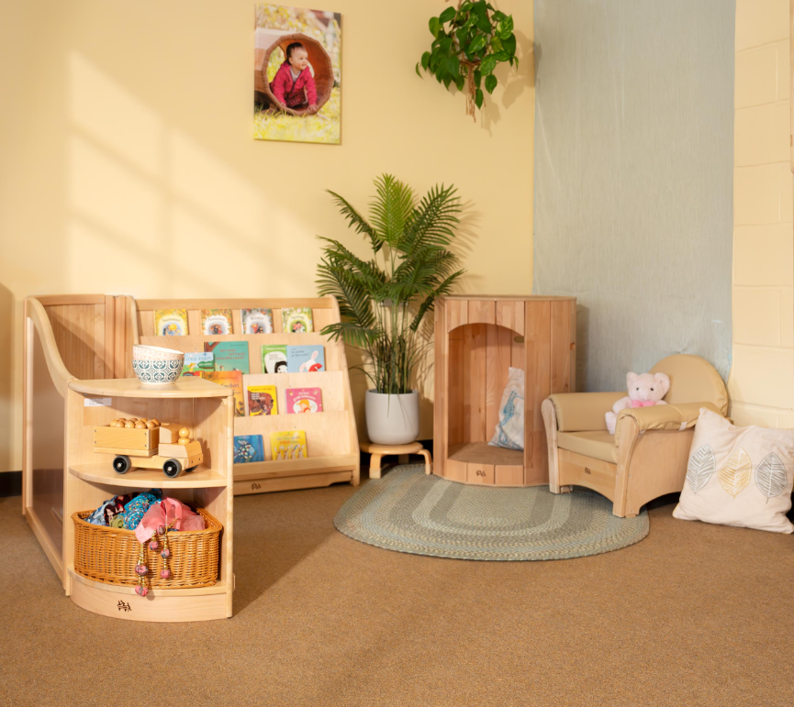
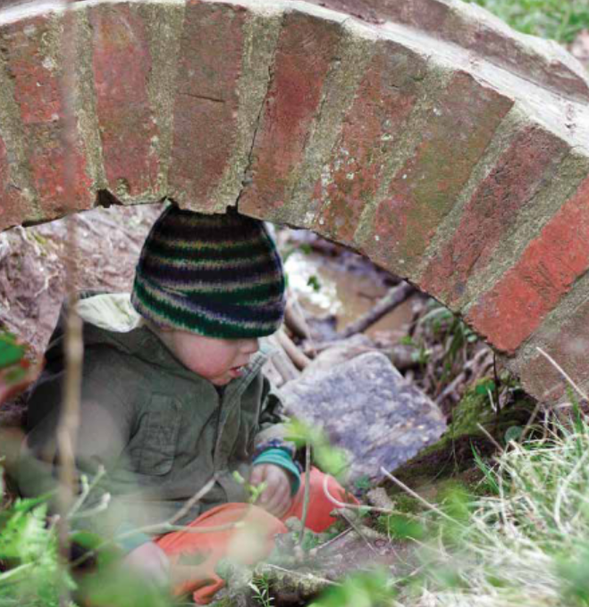
Creating a secure emotional environment:
Practitioners act as key facilitators within these environments. Their
presence, responsiveness, and
understanding of each child's cues are fundamental in supporting well-being and early learning. By offering warm interactions and consistent routines, practitioners
help children feel safe to express
themselves, try new things, and form trusting relationships.
A good place to be Two
Moreover, the partnership between practitioners and families is central to fostering a sense of continuity and trust. When families feel welcomed and engaged, children are more likely to settle confidently and build secure attachments.
A good place to be Two
5
Notes:
Do both indoor and outdoor spaces reflect all areas of the curriculum? How free is the access to outdoor play?
5

Slide 6
The indoor environment:
Learning environment | What would it look like? | Pause for thought
Social and emotional | A place where two-year-olds know that their feelings are accepted as they learn to express them. An environment where children feel confident and are willing to try things out and take risks. Children are supported to play alongside others and encouraged to take turns in cooperative games. | Are there cosy areas with soft cushions where two-year-olds can relax? Do we create ‘interest’ baskets for individual children, so they can share and discuss their fascinations? How do we vary resources to maintain interest and develop new experiences?
Communication and language | A setting that has cosy, contained, quieter areas where children can share books, sit and chat peacefully with their friends as well as adults e.g. tents. | How do we use displays and resources to stimulate conversation? How do we minimise background noise? When do we play music and why? How much time do we spend listening to children, allowing them to lead conversations, building on their vocabulary and experiences?
Physical development 2yo_toolkit.pdf | Indoor spaces that provide safe, secure yet challenging spaces for children. Stimulating spaces that support active play and exploration. | How much space is taken up by tables and chairs? How much play happens on the floor? How do we provide spaces that are for active play and also define and protect spaces that are for more contained and quieter play or rest? How are soft furnishings and drapes used to reduce background noise and make dens?
6

Slide 7
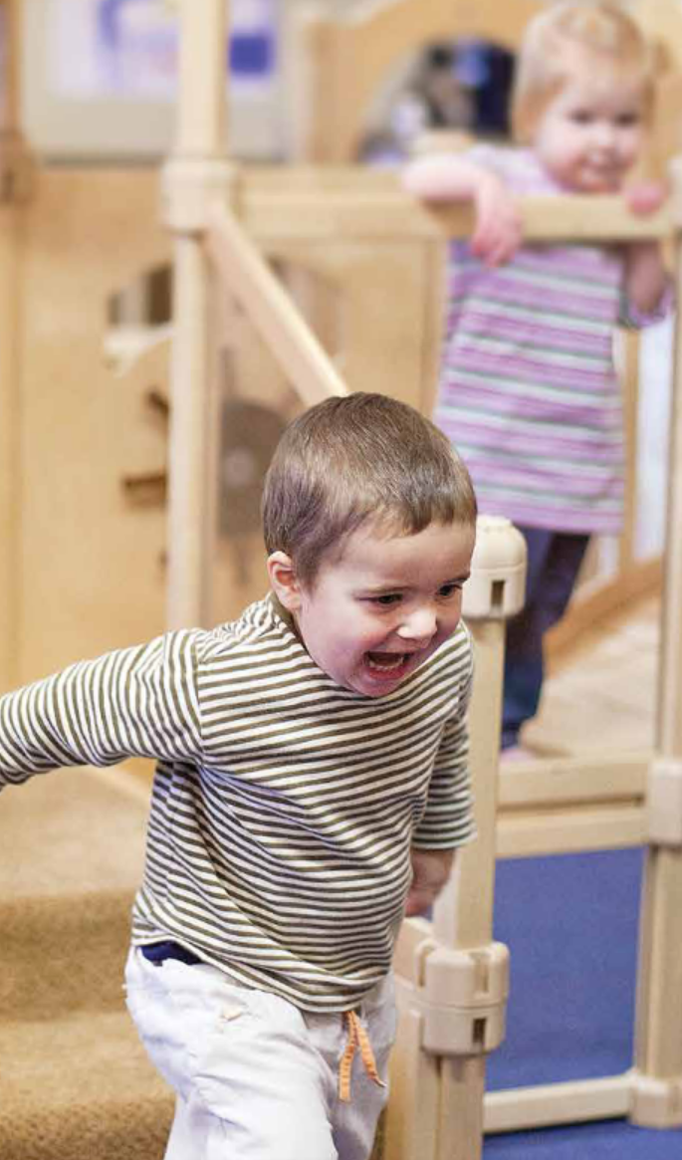
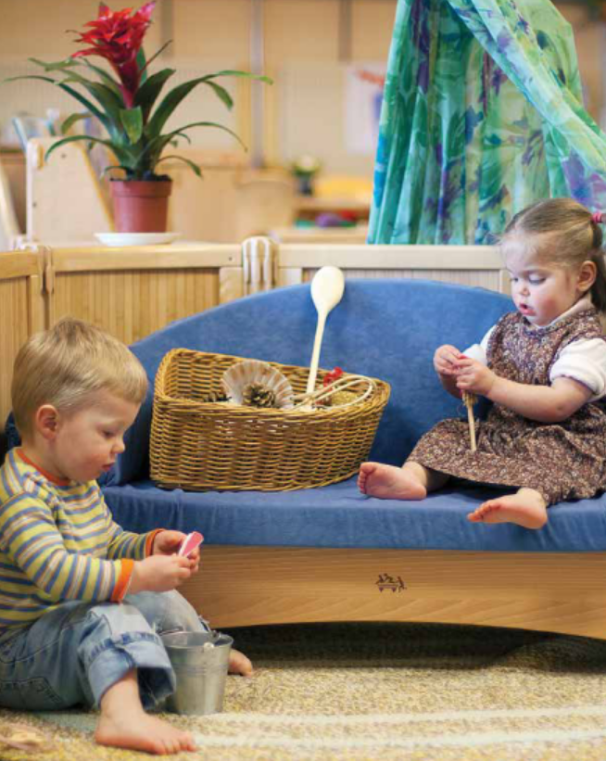
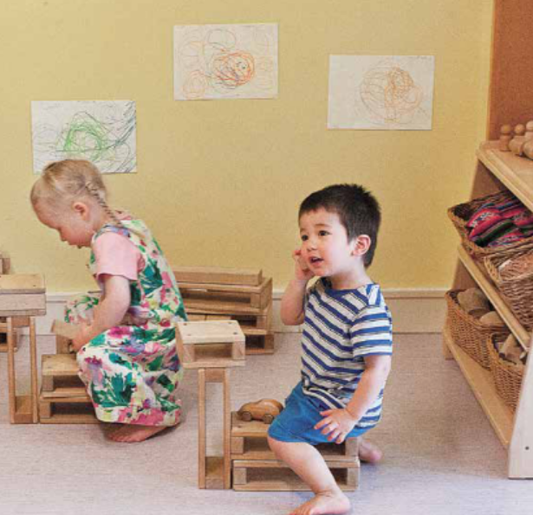
An indoor environment where children are supported to play alongside others:
A good place to be Two
7

Slide 8
The outdoor environment:
Learning environment | What would it look like? | Pause for thought
Social and emotional | A place where two-year-olds know that their feelings are accepted as they learn to express them. An environment where children feel confident and are willing to try things out and take risks. Children are supported to play alongside others and encouraged to take turns in cooperative games. | Are there cosy areas with soft cushions where two-year-olds can relax? How do we vary resources to maintain interest and develop new experiences? What resources do we have that support and develop the language needed to develop co-operation and social skills outdoors?
Communication and language | A sheltered area outside where the children can relax, chat and share books together with their friends, as well as adults. Areas where children can express joy and excitement. | How much time do we spend listening to children, allowing them to lead conversations, building on their vocabulary and sharing their experiences? How do we use a variety of open ended and found materials such as cardboard boxes, shells and corks to develop conversation, imagination and exploration?
Physical development 2yo_toolkit.pdf | A large outdoor area that provides a safe, secure yet challenging space for the children. Opportunities to get messy e.g. a mud kitchen and grow vegetables in pots. | How do we provide spaces that are for active play and also define and protect spaces that are for more contained and quieter play or rest? Are their opportunities for the children to move with their whole bodies, as well as refine their hand control and manipulation? How free is the access to the outdoor play? Are there floor coverings enabling the children to play on the ground?
8

Slide 9
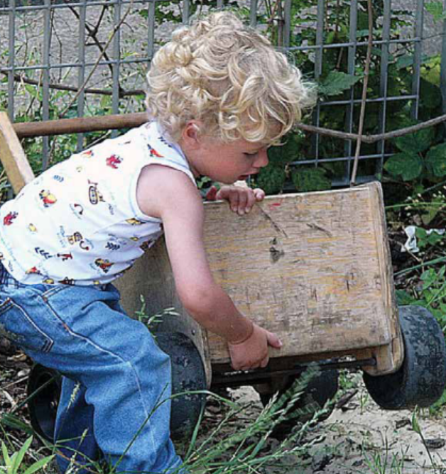
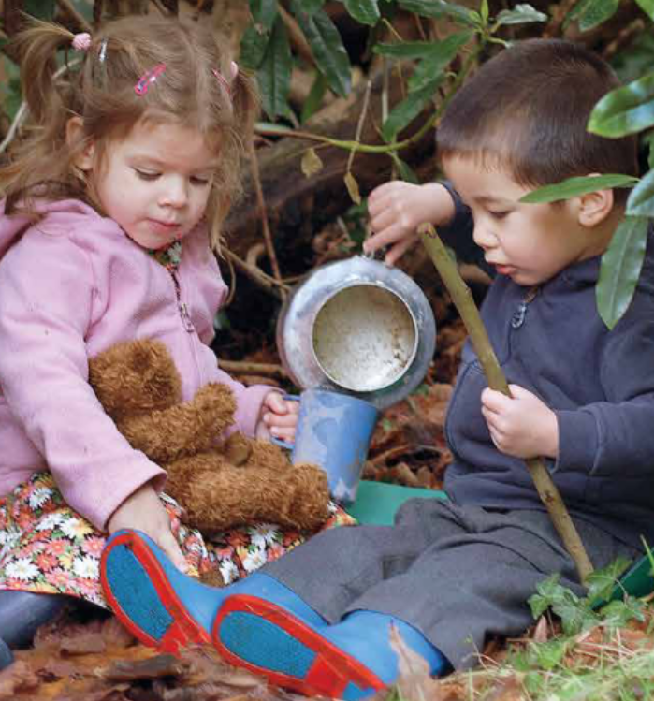
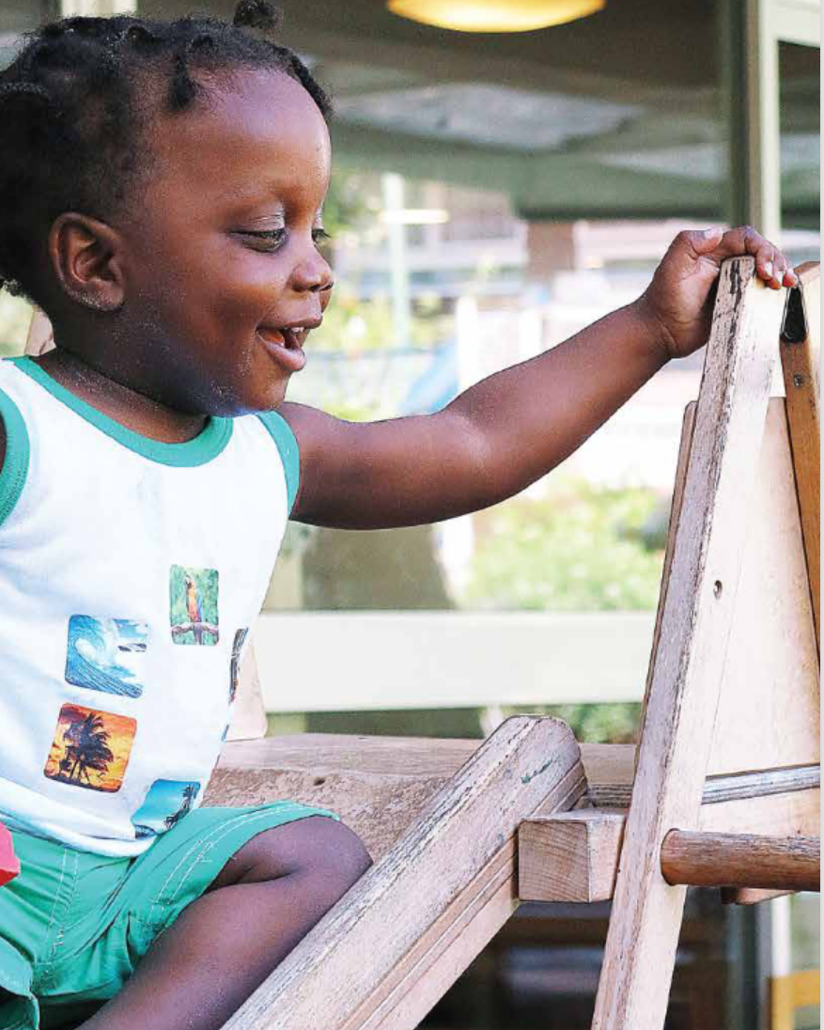
A safe, secure yet challenging outdoor space:
A good place to be Two
9

Slide 10
The characteristics of effective learning:
Area to reflect upon | What would it look like? | Pause for thought
Playing and exploring Finding out and exploring Willing to have a go Playing with known items | Two-year-olds will have interests and fascinations which can change from day to day. Children explore and discover the world using their senses. They enjoy finding out ways to use objects and have clear ideas of what they want to do, even if it involves a lot of trial and error. | How do we plan to build on children’s interests and fascinations to develop their learning? How do we ensure there is a multi-sensory approach to introducing and teaching new ideas and concepts? Do we provide opportunities for children to make simple choices?
Active Learning Keep on trying Achieving Being involved and concentrating | Two-year-olds are very eager to achieve their goals and will try again and again to do so. Two-year-olds are very proud of their achievements and are eager to share them with their important people. Two-year-olds can remain engaged and pay attention to details such as how a worm wriggles or how water feels. | Do we allow children the opportunity to consolidate previous experiences? Do we offer children the opportunity to meet and conquer a challenge (i.e. climbing a slide or painting a picture)? How do we ensure children have enough time to experience their fascinations for as long as it takes?
Creating and Thinking Critically Having their own ideas Choosing ways to do things Making links 2yo_toolkit.pdf | Two-year-olds can use materials in a variety of ways, often coming up with original ideas and ways to solve a problem they set themselves. Once set on a plan of action they may find this doesn’t work (e.g. I got this cork in the bottle, now I can’t get it out) and will come up with solutions to the problems. | Do we use open ended questions to support children’s ideas about how to solve problems (i.e. I wonder …) Do we provide enough time and space for children to try to solve their problems? Do we provide a range of cause-and-effect resources?
10

Slide 11
The areas of learning and development:
1.3/1.4 There are seven areas of learning and development that set out what childminders / providers must teach the children in their settings. All areas of learning and development are important and inter-connected.
1.4/1.5 Three prime areas are particularly important for learning and forming relationships. They build a foundation for children to thrive and provide the basis for learning in all areas. These are the prime areas: • Communication and language • Physical development • Personal, social and emotional development.
1.5/1.6 Childminders / providers must also support children in four specific areas, which help strengthen and develop the three prime areas, and ignite children’s curiosity and enthusiasm. The specific areas are: • Literacy • Mathematics • Understanding the world • Expressive arts and design.
1.6/1.7 The educational programmes are high level curriculum summaries which set out what should be taught in settings for each area of learning. They must involve activities and experiences that enable children to learn and develop, as set out under each of the seven areas of learning.
1.7/1.8 Childminders / providers should be ambitious for all children. To do this, they must consider the individual needs, interests, and development of each child in their care. They must use this information to plan a challenging and enjoyable experience for each child in all areas of learning and development. Childminders / providers working with the youngest children are expected to ensure a strong foundation for children’s development in the three prime areas. The specific areas of learning provide children with a broad curriculum and with opportunities to strengthen and apply the prime areas of learning. This is particularly important in developing language and extending vocabulary.
Statutory framework for the early years foundation stage for childminders (publishing.service.gov.uk)
Statutory framework for the early years foundation stage for group and school providers (publishing.service.gov.uk)
11

Slide 12
Personal, social and emotional development:
EYFS statutory educational programme:
Children’s personal, social and emotional development (PSED) is crucial for children to lead healthy and happy lives and is fundamental to their cognitive development. Underpinning their personal development are the important attachments that shape their social world. Strong, warm and supportive relationships with adults enable children to learn how to understand their own feelings and those of others. Children should be supported to manage emotions, develop a positive sense of self, set themselves simple goals, have confidence in their own abilities, to persist and wait for what they want and direct attention as necessary. Through adult modelling and guidance, they will learn how to look after their bodies, including healthy eating, and manage personal needs independently. Through supported interaction with other children, they learn how to make good friendships, co-operate and resolve conflicts peaceably. These attributes will provide a secure platform from which children can achieve at school and in later life. Early years foundation stage (EYFS) statutory framework - GOV.UK
12

Slide 13
Young children will be learning to: | Examples of how to support PSED:
Find ways to calm themselves, through being calmed and comforted by their key person. Establish their sense of self. Express preferences and decisions. They also try new things and start establishing their autonomy. Engage with others through gestures, gaze and talk. Use that engagement to achieve a goal. For example, gesture towards their cup to say they want a drink. Find ways of managing transitions, for example from their parent to their key person. Development Matters - Non-statutory curriculum guidance for the early years foundation stage (publishing.service.gov.uk) | When settling a young child into nursery, the top priority is for the key person to develop a strong and loving relationship with the young child. Learn from the family about what they do to soothe their child and what to look out for – for example, a baby who scratches at their head when they are getting tired. Young children develop a sense of self by interacting with others, and by exploring their bodies and objects around them, inside and outdoors. Be positive and interested in what babies do as they develop their confidence in trying new things. Help toddlers and young children to make informed choices from a limited range of options. Suggestion: enable children to choose which song to sing from a set of four song cards, by pointing. Enable children to choose whether they want milk or water at snack time. Support children as they find their own different ways to manage feelings of sadness when their parents leave them. Young children need to feel secure as they manage difficult emotions.
13

Slide 14
Young children will be learning to: | Examples of how to support PSED:
Thrive as they develop self-assurance. Play with increasing confidence on their own and with other children, because they know their key person is nearby and available. Enjoy exploring new places with their key person. Feel strong enough to express a range of emotions. Grow in independence, rejecting help (“me do it”). Sometimes this leads to feelings of frustration and tantrums. Development Matters - Non-statutory curriculum guidance for the early years foundation stage (publishing.service.gov.uk) | Provide consistent and predictable routines, with flexibility when needed. Provide consistent, warm, and responsive care. Arrange resources inside and outdoors to encourage children’s independence and growing self-confidence. Store resources so that children can access them freely, without needing help. Help children to feel emotionally safe with a key person and, gradually, with other members of staff. Show warmth and affection, combined with clear and appropriate boundaries and routines. Develop a spirit of friendly co-operation amongst children and adults. Encourage children to express their feelings through words like ‘sad’, ‘upset’ or ‘angry’. Toddlers and young children may have periods of time when their favourite word is ‘no’ and when they want to carry out their wishes straight away. Maintain sensible routines and boundaries for children during these testing times. Negative or harsh responses can cause children to feel unduly anxious and emotionally vulnerable.
14

Slide 15
Young children will be learning to: | Examples of how to support PSED:
Begin to show ‘effortful control’. For example, waiting for a turn and resisting the strong impulse to grab what they want or push their way to the front. Be increasingly able to talk about and manage their emotions. Notice and ask questions about differences, such as skin colour, types of hair, gender, special needs and disabilities, religion and so on. Develop friendships with other children. Safely explore emotions beyond their normal range through play and stories. Talk about their feelings in more elaborated ways: “I’m sad because…” or “I love it when …”. Development Matters - Non-statutory curriculum guidance for the early years foundation stage (publishing.service.gov.uk) | When appropriate, notice and talk about children’s feelings. For example: “I can see it’s hard to wait, just a minute and then it’s your turn to go down the slide.” Model useful phrases like “Can I have a turn?” or “My turn next.” Be open to what children say about differences and answer their questions straightforwardly. Help children develop positive attitudes towards diversity and inclusion. Help all children to feel that they are valued, and they belong. Support children to find ways into the play and friendship groups of others. For example, encourage them to stand and watch from the side with you. Talk about what you see, and suggest ways for the child to join in. Story times with props can engage children in a range of emotions. They can feel the family’s fear as the bear chases them at the end of ‘We’re Going on a Bear Hunt’. They can feel relief when the Gruffalo is scared away by the mouse. Recognise, talk about and expand on children’s emotions. For example, you might say: “Sara is smiling. She really wanted a turn with the truck.”
15
Notes:
15

Slide 16
Young children will be learning to: | Examples of how to support PSED:
Learn to use the toilet with help, and then independently. Development Matters - Non-statutory curriculum guidance for the early years foundation stage (publishing.service.gov.uk) | You cannot force a child to use the potty or toilet. You need to establish friendly co-operation with the child. That will help them take this important step. Children can generally control their bowels before their bladder. Notice when young children are ready to begin toilet training and discuss this with their parents: they know when they have got a wet or dirty nappy they get to know when they are peeing and may tell you they are doing it the gap between wetting is at least an hour they show they need to pee by fidgeting or going somewhere quiet or hidden they know when they need to pee and may say so in advance. Potty training is fastest if you start it when the child is at the last stage. By the age of 3, 9 out of 10 children are dry most days. All children will have the occasional ‘accident’, though, especially when excited, busy or upset.
16
Notes:
16

Slide 17
Communication and language:
EYFS statutory educational programme:
The development of children’s spoken language underpins all seven areas of learning and development. Children’s back-and-forth interactions from an early age form the foundations for language and cognitive development. The number and quality of the conversations they have with adults and peers throughout the day in a language-rich environment is crucial. By commenting on what children are interested in or doing, and echoing back what they say with new vocabulary added, practitioners will build children's language effectively. Reading frequently to children, and engaging them actively in stories, non-fiction, rhymes, and poems, and then providing them with extensive opportunities to use and embed new words in a range of contexts, will give children the opportunity to thrive. Through conversation, storytelling and role play, where children share their ideas with support and modelling from their teacher, and sensitive questioning that invites them to elaborate, children become comfortable using a rich range of vocabulary and language structures.
Early years foundation stage (EYFS) statutory framework - GOV.UK
17

Slide 18
Young children will be learning to: | Examples of how to support CL:
Make themselves understood and can become frustrated when they cannot. Start to say how they are feeling, using words as well as actions. Start to develop conversation, often jumping from topic to topic. Develop pretend play: ‘putting the baby to sleep’ or ‘driving the cars to the shops’. Use the speech sounds p, b, m, w. Pronounce: l/r/w/y f/th s/sh/ch/dz/j/multi-syllabic words such as ‘banana’ and ‘computer’. Development Matters - Non-statutory curriculum guidance for the early years foundation stage (publishing.service.gov.uk) | You can help toddlers who are having tantrums by being calm and reassuring. Help toddlers to express what’s angering them by suggesting words to describe their emotions, like ‘sad’ or ‘angry’. You can help further by explaining in simple terms why you think they may be feeling that emotion. Make time to connect with young children. Tune in and listen to them and join in with their play, indoors and outside. Allow plenty of time to have conversations together, rather than busily rushing from one activity to the next. When you know a young child well, it is easier to understand them and talk about their family life. Toddlers and young children sometimes hesitate and repeat sounds and words when thinking what to say. Listen patiently. Do not say the words for them. If the child or parent carer are distressed or worried about this, contact a speech and language therapist for advice. Encourage children to talk. Do not use too many questions: four comments to every question is a useful guide.
18
Notes:
18

Slide 19
Young children will be learning to: | Examples of how to support CL:
Listen to simple stories and understand what is happening, with the help of the pictures. Identify familiar objects and properties for practitioners when they are described e.g. ‘Katie’s coat’, ‘blue car’, ‘shiny apple’. Understand and act on longer sentences like ‘make teddy jump’ or ‘find your coat’. Understand simple questions about ‘who’, ‘what’ and ‘where’ (but generally not ‘why’). Development Matters - Non-statutory curriculum guidance for the early years foundation stage (publishing.service.gov.uk) | Share picture books every day with children. Encourage them to talk about the pictures and the story. Comment on the pictures e.g. “It looks like the boy is a bit worried …” and wait for a response. You might also ask them about the pictures: “I wonder what the caterpillar is doing now?” Books with just pictures and no words can encourage conversations. Tell children the names of things they do not know and choose books that introduce interesting new vocabulary to them. When appropriate, you can check children’s understanding by asking them to point to particular pictures. Or ask them to point to particular objects in a picture e.g. “Can you show me the big boat?” When talking with you children, give them plenty of processing time (at least 10 seconds). This gives them time to understand what you have said and think of their reply.
19
Notes:
19

Slide 20
Physical development:
EYFS statutory educational programme:
Physical activity is vital in children’s all-round development, enabling them to pursue happy, healthy and active lives. Gross and fine motor experiences develop incrementally throughout early childhood, starting with sensory explorations and the development of a child’s strength, co-ordination and positional awareness through tummy time, crawling and play movement with both objects and adults. By creating games and providing opportunities for play both indoors and outdoors, adults can support children to develop their core strength, stability, balance, spatial awareness, co-ordination and agility. Gross motor skills provide the foundation for developing healthy bodies and social and emotional well-being. Fine motor control and precision helps with hand-eye co-ordination, which is later linked to early literacy. Repeated and varied opportunities to explore and play with small world activities, puzzles, arts and crafts and the practice of using small tools, with feedback and support from adults, allow children to develop proficiency, control and confidence.
Early years foundation stage (EYFS) statutory framework - GOV.UK (www.gov.uk)
20

Slide 21
Young children will be learning to: | Examples of how to support PD:
Gradually gain control of their whole body through continual practice of large movements, such as waving, kicking, rolling, crawling and walking. Clap and stamp to music. Fit themselves into spaces, like tunnels, dens and large boxes, and move around in them. Enjoy starting to kick, throw and catch balls. Build independently with a range of appropriate resources. Walk, run, jump and climb – and start to use the stairs independently. Development Matters - Non-statutory curriculum guidance for the early years foundation stage (publishing.service.gov.uk) | Provide a wide range of opportunities for children to move throughout the day: indoors and outside, alone or with others, with and without apparatus. Include risky and rough and tumble play, as appropriate. Join in with children’s movement play when invited and if it is appropriate. Then you can show different ways of moving and engaging with the resources. Help young children learn what physical risks they are confident and able to take. Encourage children to climb unaided and to stop if they don’t feel safe. If you lift them onto the apparatus and hold them so they balance, they will not develop a sense of what they can do safely. Offer outdoor play every day for at least 45 minutes. Include lots of opportunities for children to move freely and explore their surroundings like a slope, a large hole, puddles or a sandpit. Consider wider opportunities for movement. Suggestions: using large moveable resources like hollow blocks, swinging on monkey bars, soft play, climbing walls, crawling into tunnels and dens. Consider going to suitable local facilities.
21
Notes:
21

Slide 22
Young children will be learning to: | Examples of how to support PD:
Walk, run, jump and climb – and start to use the stairs independently. Spin, roll and independently use ropes and swings (for example, tyre swings). Sit on a push-along wheeled toy, use a scooter or ride a tricycle. Use large and small motor skills to do things independently, for example manage buttons and zips, and pour drinks. Show an increasing desire to be independent, such as wanting to feed themselves and dress or undress. Development Matters - Non-statutory curriculum guidance for the early years foundation stage (publishing.service.gov.uk) | As soon as children are able, encourage ‘active travel’ to and from the setting e.g. walking, scooter or bike. Provide materials and equipment that support physical development – both large and small motor skills. Encourage children to use materials flexibly and combine them in different ways. Check that children’s clothing and footwear are not too tight or too large. Provide young children with lots of opportunities to feed themselves. Encourage them to dress and undress independently. Be patient, do not rush and take time to talk about what they are doing and why: “It’s a bit cold and wet today – what do we need to wear to keep warm and dry?”
22
Notes:
22

Slide 23
Young children will be learning to: | Examples of how to support PD:
Start eating independently and learning how to use a knife and fork. Develop manipulation and control. Explore different materials and tools. Development Matters - Non-statutory curriculum guidance for the early years foundation stage (publishing.service.gov.uk) | Encourage young children’s personal decision-making by offering real choices – water or milk, for example. They can comment on how to eat healthily, listen to children’s responses and develop conversations about this. Encourage good eating habits and behaviours, such as not snatching, sharing and waiting for a second helping. Provide different types of paper for children to tear, make marks on and print on. Provide lots of different things for young children to grasp, hold and explore, like clay, finger paint, spoons, brushes, shells. Note: Look out for children who find it difficult to sit comfortably on chairs. They may need help to develop their core muscles. You can help them by encouraging them to scoot on sit-down trikes without pedals and jump on soft-play equipment.
23
Notes:
23

Slide 24
Assessment:
 | Observational checkpoints for 18 months
CL | Is the toddler listening and responding to a simple instruction like: “Adam, put on your shoes”? Can the toddler use a range of adult like speech patterns (Jargon) and at least 20 clear words? Does the toddler understand lots of single words and some two-word phrases, such as “give me” or “shoes on”?
PSED | Is the toddler increasingly curious about their world and wanting to explore it and be noticed by you?
 | Observational checkpoints for 24 months
CL | Is the child showing an interest in what other children are playing and sometimes joins in? Can the child use up to 50 words? Is the child beginning to put two or three words together e.g. “more milk”? Can the child understand many more words that they say – between 200 – 500 words? Can the child understand simple questions and instructions like: “Where’s your hat?” or “What’s the boy in the picture doing?”
PSED | Does the child start to see themselves as a aseparate person? E.g. do they decide what to play with, what to eat, what to wear? Does the child start to enjoy the company of other children and want to play with them?
PD | Can the toddler run well, kick ball and jump with both feet off the ground at the same time? Development Matters - Non-statutory curriculum guidance for the early years foundation stage (publishing.service.gov.uk)
24

Slide 25
Assessment (cont.):
 | Observational checkpoints for 36 months
CL | Can the child shift back from one task to another if you get their attention, using the child’s name to help? Can the child use around 300 words? These include descriptive language. They include words for time (e.g. now, later), space (e.g. over there) and function (e.g. they can tell you a sponge is for washing). Is the child linking up to 5 words together? Is the child using pronouns (me, him, she) and using plurals and prepositions (in, on, under) – these may not always be used correctly to start with. Can the child follow instructions with 3 key words like: “Can you wash dolly’s face?” Can the child show that they understand action words by pointing to the right picture in a book e.g. “who’s jumping?” Can the child shift from one task to another if you fully obtain their attention e.g. by using their name?
PSED | Does the child start to enjoy the company of other children and want to play with them? Can the child sometimes manage to share or take turns with others, with adult guidance and understanding ‘yours’ and ‘mine’? Can the child settle to some activities for a while?
PD | Can the child climb confidently, catch a large ball and pedal a tricycle? Development Matters - Non-statutory curriculum guidance for the early years foundation stage (publishing.service.gov.uk)
25

Slide 26


Assessment (cont.):
The Early Communication Screening Tool:
The Early Communication Screen is a quick, easy to administer screening tool designed to be delivered by practitioners with children from 2-5 years of age. This screening tool can be used to identify difficulties in understanding and spoken language skills and the results enable practitioners to plan appropriate interventions and measure progress. The training will give participants the skills and knowledge to administer the Early Communication Screen accurately and interrupt the results effectively.
Details of the next training session can be found at: CPD schedule and booking details | Shropshire Learning Gateway
Further advice on how to support children with speech, language and communication needs, can be found at: Speech & language therapy
The document Early Communication Screening Tool – What Next? offering suggestions to help support children to understand the concepts and vocabulary they may have found challenging during the screening, can be found at: EYFS Documentation and Links | Shropshire Learning Gateway
26

Slide 27
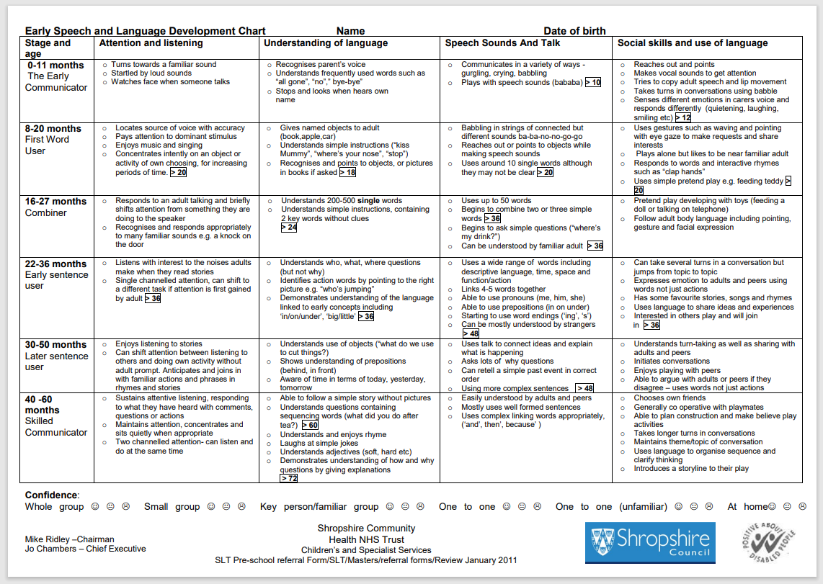
Assessment (cont.):
The Early Speech and Language Development Chart:
seld-with-logos.pdf
27

Slide 28
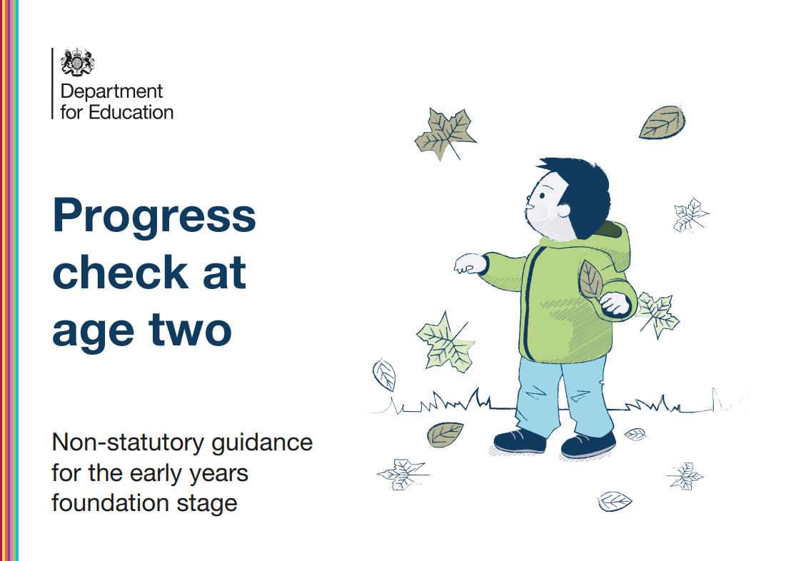
Assessment (cont.):
Guidance to provide support for early years practitioners when completing the early years foundation stage (EYFS) progress check at 2.
Progress check at age two – Non-statutory guidance for the early years foundation stage
28

Slide 29
Specific safeguarding and welfare requirements for two-year-olds:
 | Childminders | Group and school based settings
Food and drink | 3.62 | 3.62
Food and drink facilities | 3.71 | 3.71
Key person | 3.46 | 3.41
Paediatric first aid | 3.42 – 3.44 | 3.36 – 3.39
Safer eating | 3.63 – 3.70 | 3.63 – 3.70
Staff: child ratios | 3.47 – 3.57 | 3.42 – 3.56
Sleeping arrangements | 3.85 | 3.84
Toilets and intimate care | 3.86 | 3.86
References to paragraphs within the EYFS statutory framework for childminders:
Early years foundation stage statutory framework for childminders
References to paragraphs within the EYFS statutory framework for and group and school-based providers:
EYFS statutory framework for group and school-based providers
29

Slide 30
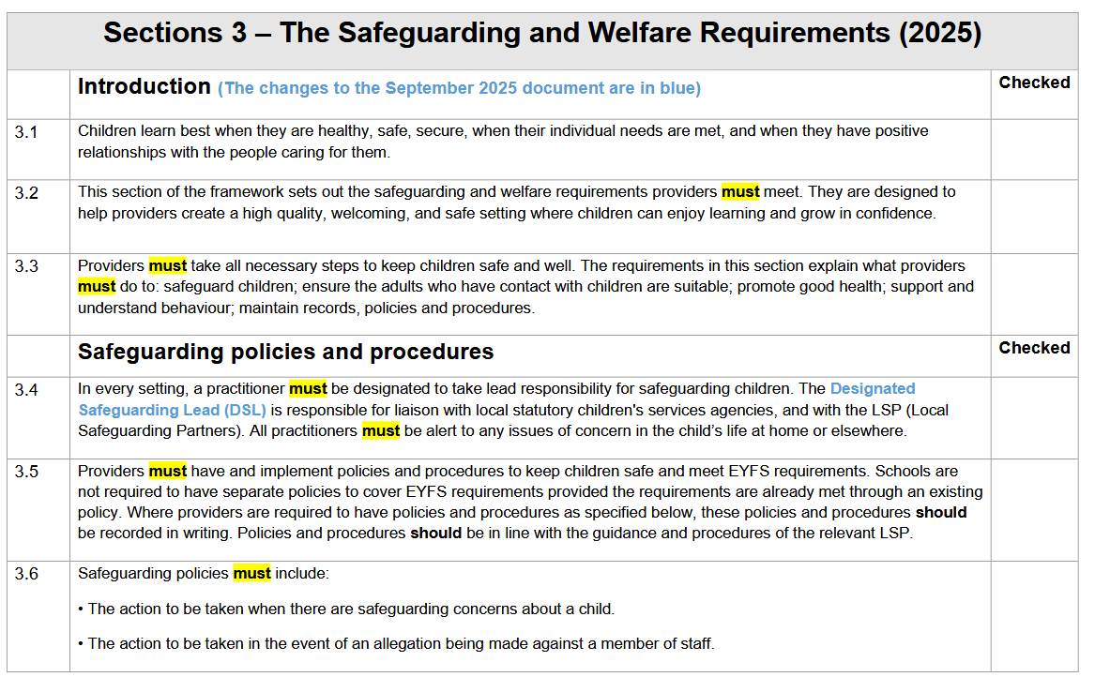
An audit of the musts in the EYFS statutory framework (2025) can be found at: EYFS Documentation | Shropshire Learning Gateway
30
Notes:
30

Slide 31
References and further reading:
A good place to be Two | Training resources | Community Playthings (2013) This booklet covers all aspects of the environment indoors and out for two-year-olds.
Best Books for 2-year-olds | BookTrust Suggested books for children aged 2-years of age.
Birthto5Matters-download.pdf (2021) Non-statutory guidance for the Early Years Foundation Stage (EYFS).
Children's language development and parenting advice - BBC Tiny Happy People (2023) Activities to help support their children’s communication and language development.
Development Matters - GOV.UK (2023) Non-statutory curriculum guidance for the EYFS.
Early years child development training: Home page (education.gov.uk) (2023) This free, online training provides an overview of child development and gives practical advice for supporting the development of children in your early years setting.
Early Years & KS1 Free Audits & Guides | Early Excellence (2023) An audit check on the quality of provision for 2–3-year-olds
Froebel-Trust-PDF-Research-Highlight-Book-One.pdf Nursery attachments and the role of the key person.
Help for early years providers : Physical development Understand why physical development is important to early years children.
Nutbrown, C. (2011) Threads of Thinking: Schemas and Young Children’s Learning. 4th edn. SAGE Publications Ltd.
31

Slide 32
References and further reading (cont.):
Page, J., Clare, C. and Nutbrown, C. (2013) Working with babies and children: From birth to three. 2nd edn. SAGE Publications Ltd.
Parental engagement | EEF (educationendowmentfoundation.org.uk) Parental engagement approaches have, on average, a positive impact of five months’ additional progress. It is crucial to consider how to engage with all parents to avoid widening attainment gaps. There is extensive evidence on the positive impact of parental engagement approaches.
Play schemas and why they matter | Famly (2024) Everything you need to know about schemas.
Physical development in early childhood - Early Education (early-education.org.uk) Exploring the importance of physicality at this crucial point in a child’s development.
Tassoni, P. (2014) Getting it right for Two Year Olds. Hodder Education
the-cfs-approach-and-targeted-use-of-colour.pdf (elizabethjarman.com) (2018) Further information on the Communication Friendly Spaces approach.
Twoness of twos (2025) This report continues to advocate for specific training for leading a 2 – year-old room.
Two Year Olds in a Mixed Age Group by Kathy Brodie (abcdoes.com) (2012) In this blog, Kathy Brodie reflects on two-year-olds in a mixed aged group.
What-to-expect-in-the-EYFS-complete-FINAL-16.09-compressed.pdf (foundationyears.org.uk) A guide for parent carers on the EYFS.
32

